Slide 1
Today’s “Plan”—Tuesday March 7, 2022
Attendance/Seating Chart
What will you need for this class?
Introductory email
“Getting Acquainted”

Slide 2

What will you need for this class?
Materials for this class:
Writing utensil (pen, pencil, I don’t really care!)
iPad
If asked nicely to do something (or not do something)… DO IT!
If something doesn’t pertain to you, LEAVE IT ALONE!

Slide 3
Introductory Activity
Compose an email to joe_frey@estesschools.org or
joe_frey@psdr3.k12.co.us
For the subject, type “Intro STEAM Activity”
If you could be any animal (besides a human), what would you be and why?
If you could live anywhere in the world, where would it be, and why?
What might you want to be when you grow up?
Tell us one other thing about yourself.
When finished, send it!

Slide 4
Getting Acquainted Activity
You will be interviewing your new friend (table partner). You write their answers down on your paper.
When finished, take a picture and submit to Schoology:
    It is called Getting Acquainted Questions
Then make a Keynote (or something similar) that focuses on 4 of those questions about your friend.
    Submit to “About My Friend”

Slide 5
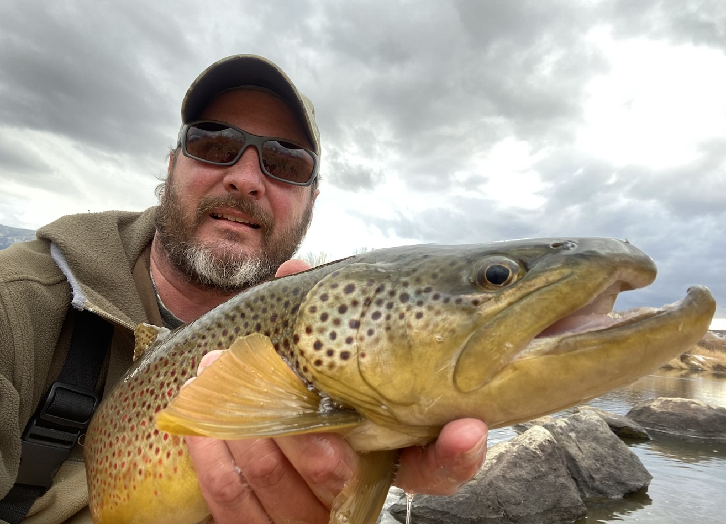
My friend is Joe Frey
His favorite hobby is fishing
  Fishes over 100 days a year.
His favorite place that he has visited is Alaska
  Wants to live there someday (and it might be soon!).
Something he is good at is shooting
  Won a World Championship in competitive pistol shooting in 2014.
He is scared of snakes!
  Had lots of snakes growing up in the Ozarks.

Slide 6
Today’s “Plan”—Wednesday March 8, 2022
Attendance/Seating Chart
Reminders of what will you need for this class?
Present some “About My Friend” projects
Kahoot: Science & STEAM
Introduce first big project
Why do things float?
  Archimedes’ Principle
  Go over Boat Building parameters
Finish “About My Friend” presentations
Start planning your boat

Slide 7
What will you need for this class?
Materials for this class:
Writing utensil (pen, pencil, I don’t really care!)
iPad
If asked nicely to do something (or not do something)… DO IT!
If something doesn’t pertain to you, LEAVE IT ALONE!

Slide 8
Getting Acquainted Activity
You will be interviewing your new friend (table partner). You write their answers down on your paper.
When finished, take a picture and submit to Schoology:
    It is called Getting Acquainted Questions
Then make a Keynote (or something similar) that focuses on 4 of those questions about your friend.
    Submit to “About My Friend”

Slide 9
My friend is Joe Frey
His favorite hobby is fishing
  Fishes over 100 days a year.
His favorite place that he has visited is Alaska
  Wants to live there someday (and it might be soon!).
Something he is good at is shooting
  Won a World Championship in competitive pistol shooting in 2014.
He is scared of snakes!
  Had lots of snakes growing up in the Ozarks.

Slide 10
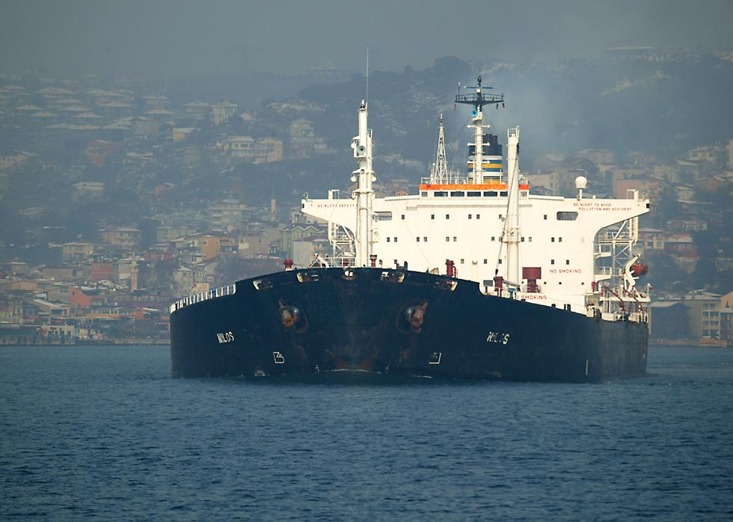
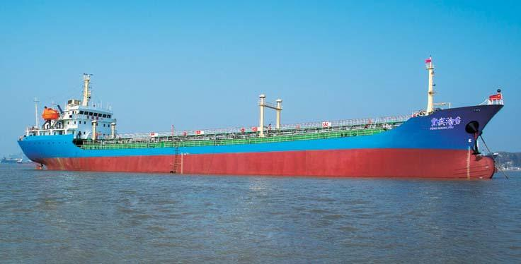
Archimedes’ Principle
Archimedes’ Principle states that the buoyant force acting on a submerged object is equal to the weight of the fluid the object displaces.

Slide 11
Buoyant Force—force of a fluid pushing up on an object to allow it to float.
ex: a floating ship
As long as the amount of water displaced by the ship
can equal the weight of the ship, it will float.

Slide 12
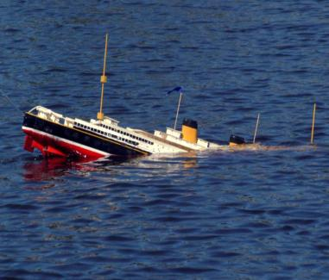
If the weight of the ship/object exceeds (is greater than) the weight of the water that it displaces, it will sink.

Slide 13
Today’s “Plan”—Thursday March 9, 2022
Attendance/Brain Stretcher
Reminders of what will you need for this class.
Present some more “About My Friend” projects
Will it float?
Reminders on Boat Building Project
Finish “About My Friend” presentations
Start building your boat

Slide 14
What will you need for this class?
Materials for this class:
Writing utensil (pen, pencil, I don’t really care!)
iPad
If asked nicely to do something (or not do something)… DO IT!
If something doesn’t pertain to you, LEAVE IT ALONE!

Slide 15
Boat Building Project:
Materials provided:
Aluminum foil (3’ x 1’)
12 straws
Duct Tape (not excessive)
Hot glue
Only thing you can add on own:
1 layer of cardboard for floor
Must be on the inside of the aluminum foil
Make sure and put your name on your boat!

Slide 16
Today’s “Plan”—Monday March 13, 2022
Attendance/Brain Stretcher
Present some more “About My Friend” projects
Reminders on Boat Building Project
Give time to finish boats
Start sinking some boats!

Slide 17
Today’s “Plan”—Tuesday March 14, 2022
Attendance/Brain Stretcher
Present some more “About My Friend” projects
Kahoot about Ships!
Who still needs to finish their boat?
Go sink some more boats!

Slide 18
Today’s “Plan”—Wednesday March 15, 2022
Attendance/Brain Stretcher
Any more “About My Friend” projects
Who still needs to finish their 1st boat?
Scoring for Round 1
Finish paragraph from yesterday
Start Round 2 boat—you must beat your old boat’s score.

Slide 19
Boat Reflection
We recently completed a boat building competition which involved being able to hold the most weight. My boat held _______, which was _____________________________
_________________________. What I will do differently for next time will be _____________________________________
______________________. By adding these improvements, I think I will do better on my second boat.

Slide 20
Today’s “Plan”—Thursday March 16, 2022
Attendance
Who still needs to finish their 1st boat?
Scoring for Round 2: For full credit, you need to:
    0-500 grams needs 50% increase
    500-999 needs 30% increase
    1000-1999 needs 10% increase
    2000 and up needs to increase
Finish paragraph from yesterday
Start Round 2 boat—you must beat your old boat’s score.

Slide 21
Boat Reflection
We recently completed a boat building competition which involved being able to hold the most weight. My boat held _______, which was _____________________________
_________________________. What I will do differently for next time will be _____________________________________
______________________. By adding these improvements, I think I will do better on my second boat.

Slide 22
Today’s “Plan”—Monday March 20, 2022
Attendance
Boat paragraphs
Who still needs to sink their 2nd boat?
Scoring for Round 2: For full credit, you need to:
    0-500 grams needs 50% increase
    500-999 needs 30% increase
    1000-1999 needs 10% increase
    2000 and up needs to increase
PHET simulations on estesparksteam.com
  Play at least 2 different simulations
  For each simulation:
      Name the simulation
      Define each of the topics.
      Explain how they are used in the simulation
  When finished, turn in to 2 simulations

Slide 23
Today’s “Plan”—Tuesday March 21, 2022
Attendance
Who still needs to sink their 2nd boat?
Scoring for Round 2: For full credit, you need to:
    0-500 grams needs 50% increase
    500-999 needs 30% increase
    1000-1999 needs 10% increase
    2000 and up needs to increase
PHET simulations on estesparksteam.com
  Play at least 2 different simulations
  For each simulation:
      Name the simulation
      Define each of the topics.
      Explain how they are used in the simulation
  When finished, turn in to 2 simulations

Slide 24
Today’s “Plan”—Wednesday March 22, 2023
Attendance
Begin The Design Process
    Brainstorm: All-time top inventions/innovations
    Video: Top 10 Inventions
    The Design Process on estesparksteam.com
    Brainstorm ”Million Dollar Idea!”

Slide 25
Today’s “Plan”—Thursday March 23, 2023
Attendance/Brain Stretcher
Kahoot: Inventors & Innovators
These things need to be turned in before starting to create your pitch:
    Million Dollar Idea—(briefly explain your idea)
    Product Name
    Logo

Slide 26
Today’s “Plan”—Freyday March 24, 2023
Attendance
Video: Top Logos
These things need to be turned in before starting to create your pitch:
    Million Dollar Idea—(what is your idea?)
    Product Name
    Logo
    Then start thinking of your item’s key selling points.
    What makes it different than other products at there?
    Why will I pick your product over somebody else’s product?
    If you finish all of that, then begin planning out your script for your pitch

Slide 27








Types of Logos
Wordmark:
Abstract Icon:
Logo System:
Pictoral:

Slide 29



Slide 30
Today’s “Plan”—Monday April 3, 2023
Attendance
Video: Top Shark Tank Pitches
These things need to be turned in before starting to create your pitch:
    Million Dollar Idea—(what is your idea?)
    Product Name
    Logo
    Then start thinking of your item’s key selling points.
    What makes it different than other products out there?
    Why will I pick your product over somebody else’s product?
    If you finish all of that, then begin planning out your script for your pitch

Slide 31
Compose an email to me:
Subject: Plan
Tell me briefly what your idea is, and who you are doing it with.

Slide 32
Today’s “Plan”—Wednesday April 5, 2023
Attendance/Seating Chart by groupings
  Need plan from Leo, Carter, & Abel
Video: How to Write a Script for Your Pitch
Review Logos
These things need to be turned in:
    Million Dollar Idea—(what is your idea?)
    Product Name
    Logo
    Then start thinking of your item’s key selling points.
    What makes it different than other products out there?
    Why will I pick your product over somebody else’s product?
    If you finish all of that, then begin planning out your script for your pitch

Slide 33

Types of Logos
Wordmark:
Abstract Icon:
Logo System:
Pictoral:

Slide 36
Today’s “Plan”—Thursday April 6, 2023
Attendance/Seating Chart by groupings
  Need plan from Leo, Carter, & Abel
Video: 10 Most Successful Shark Tank Businesses
These things need to be turned in by the end of class today:
    Million Dollar Idea—(what is your idea?)
    Product Name
    Logo
    Then start thinking of your item’s key selling points.
    What makes it different than other products out there?
    Why will I pick your product over somebody else’s product?
    If you finish all of that, then begin planning out your script for your pitch

Slide 37
Today’s “Plan”—Freyday April 7, 2023
Attendance/Seating Chart by groupings
  Need plan from Leo, Carter, & Abel
Video: 10 Selling “As Seen on TV” Products
These things should be turned in:
    Million Dollar Idea—(what is your idea?)
    Product Name
    Logo
    Then start thinking of your item’s key selling points.
    What makes it different than other products out there?
    Why will I pick your product over somebody else’s product?
    If you finish all of that, then begin planning out your script for your pitch

Slide 38
Today’s “Plan”—Monday April 10, 2023
Attendance.
Kahoot: Which Came First?
These things should be turned in:
    Million Dollar Idea—(what is your idea?)
    Product Name
    Logo
    Then start thinking of your item’s key selling points.
    What makes it different than other products out there?
    Why will I pick your product over somebody else’s product?
    If you finish all of that, then begin planning out your script for your pitch
    I would like to start presenting on Wednesday!

Slide 39
Parts of a Pitch:
Hook
    You have 5-10 seconds to get them engaged.
    What are you going to do to make them keep watching?
Intro
    This is also short—briefly tell them who you are/what your product is, and a couple of key things about it.
Body
    Longer
    Give more specific details/information about your product
    Why is your product better than others out there?
Call to Action
    Give them a reason to act now!

Slide 40
Today’s “Plan”—Tuesday April 11, 2023
Attendance.
Check in to see where people are at.
    Live vs Video?
What are your item’s key selling points
    What makes it different than other products out there?
    Why would we pick your product over somebody else’s product?
    Write these down in a Doc, submit to Selling Points
Submit your Script
Submit your Pitch
    This is either your video or if you are doing it live, it is probably a slide show showing your logo, product name, key things about the product, sketches of your product, etc.

Slide 41
Today’s “Plan”—Monday April 17, 2023
Attendance
Will begin presenting pitches today
Explain evaluation process
Present pitches

Slide 42
Today’s “Plan”—Tuesday April 18, 2023
Attendance
Competition with 3 more pitches
    Do evaluations for each pitch
    Tally up votes
People who aren’t done with video or creating pitch—get done!
At 2:23pm, stack chairs & wipe tables please!

