Slide 1
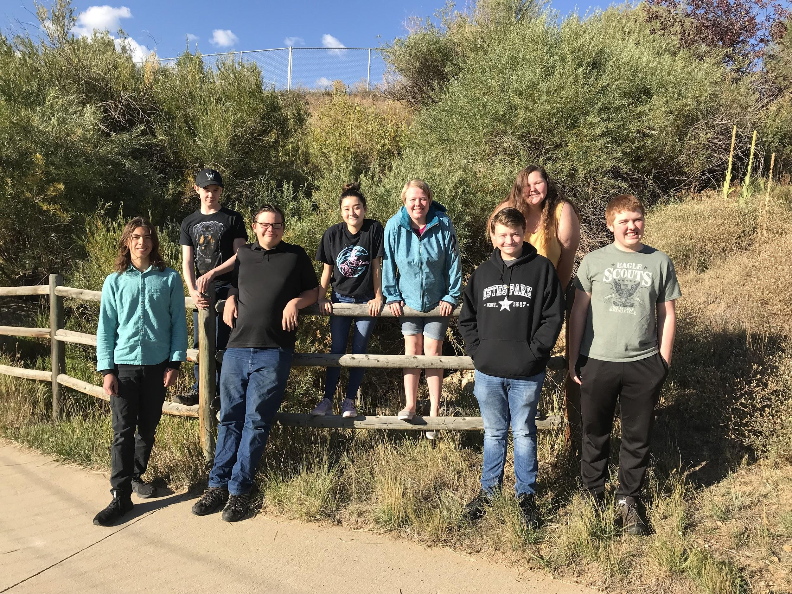
Land & Water Challenge
Pam Frey
Recyclers of the Rockies
Ellie Bergsten, Naeco Pasternak, Noah West, Savina Apodaca Luna, Zach Mey. Kaci Musick, Eric Novak, Adrial Fisher
Estes Park High school
Estes Park, Colorado
Chuck Scott
‹#›
Notes:
‹#›

Slide 2
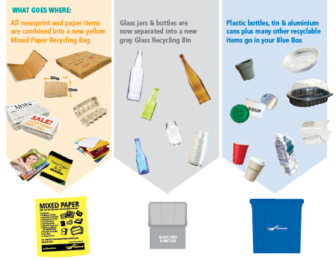
Recycling
What is Recycling?
The separation of materials that is then collected
Materials that would be considered waste
The materials are then processed to make new items
Why did we choose this topic?
Recyclers of the Rockies decided to focus on this topic because we thought we could make a big impact in our school
Lots of people don’t know what needs to go into recycling
We are going to make a video to educate the students in our school
‹#›
Notes:
‹#›

Slide 3
Our Action Plan
We are working at our High School to educate the students about the ways recycling affects us and what can be recycled.
The Recyclers of the Rockies is working with the Environmental club to reduce the amount of contaminants in the recycling
On the 28th of September we will walk and collect the recycling with the Environmental Club around the school and calculate the contamination rate
We will educate our school and collect recycling again on the 12th of October to see if there is less contamination
‹#›
Notes:
‹#›

Slide 4
Recycling statistics
According to an article in the New York Times, 25% of recycling goes to the landfill per year
Colorado only recycles 12% of its waste
The National Average of waste recycled is 34%
In Colorado, Loveland, Boulder, and Louisville recycle 50% or more of household waste
Colorado has one of the lowest rates of people who recycle in the nation
Cartons are the #1 material that people don’t realize that can be recycled
‹#›
Notes:
‹#›

Slide 5
Action Plan (continued)
We will collect the recycling, separate the contaminates, and weigh both parts of the recycling
Then make an educational video about recycling and show it to the Bobcat Advisory classes.
We will make posters that relate to the video on all the lockers as well as posters that go on the recycling bins that tell you what does and doesn’t go into the recycling bin
Once we show the video we will then go around and collect the recycling again
Separating the two parts and weigh them again
Then compare the results before the video and after the video
‹#›
Notes:
‹#›

Slide 6
Action Plan (continued)
TEAM RESPONSIBILITIES:
Website: Naeco and Kaci
Videographer: Zach and Noah
Video Editing: Zach and Noah
PowerPoint: Ellie and Savina
Article writing: Ellie
Research: Eric, Adrial and Zach
Secretary: Ellie
Data Collector: Naeco and Kaci
COMMUNITY MEMBERS:
Scott Esser: Rocky Mountain National Park (RMNP) Ecologist
Taylor Bobowski: Estes Park Environmental Center
Deb Callahan: Water Quality for the Town of Estes Park
Nathan Zurfluh: President of the Environmental Club
Judi Smith: Former Chair of Recycling
‹#›
Notes:
‹#›

Slide 7
Implication
First we had the brainstorming event with our community members
We wrote an article to go into the local paper
We talked to the League of Women Voters about the Transfer Station, what happens to the recycling, and goes into the recycling and what doesn’t
We walked around with The President of the Environmental Club, Nathan Zurfluh, and sorted recycling into what is trash and what actually was recycling
We calculated the results of how many pounds of trash and recycling we had, and got a percent of how much was waste
After recycling we made a video about what goes in the recycle bin and what doesn’t
We showed the video to all of the Bobcat Advisory classes, and the Civics classes
We walked around and collected the recycling and separated it again
We got the results of this week's recycling after the video was shown
We compared the data
‹#›
Notes:
‹#›

Slide 8
Implementation (continued)
We created a video that tells the students of Estes Park High School in the Bobcat Advisory and the Civics classes
We worked with The League of Women Voters Chair of Recycling, The head of the Environmental Club at the school, An Ecologist from RMNP, The Town of Estes Park’s Manager of Water Quality, and the head of the Estes Park Environmental Center
We had an article posted in the news paper about what we were doing
We showed the video to the school
We made a website about what we were doing with the paper, we linked the video and explained what the project was
We made posters for classroom recycling bins and lockers
‹#›
Notes:
‹#›

Slide 9
Implementation (continued)
Our website:
https://www.estesparksteam.com/pam-steam
The article we wrote (pg. 26 Brainstorming with the Estes Park STEAM Class)
https://issuu.com/estesparknews/docs/epn092118-webfile/26
‹#›
Notes:
‹#›

Slide 10
Our Results
Our data:
September 28th
10% was trash
90% was actually recycling
October 12
8.59% was trash
91.41% was actually recycling
Reduced by 1.41%
Our plan was successful; we did reduce the amount of trash and with continued efforts we will reduce the trash even more
‹#›
Notes:
‹#›

Slide 11
What we learned
Our high school was actually pretty good at recycling
The things we were taught when we were little didn’t really give us all the information which led to some misconceptions
We learned that we can not recycle paper towels, tissues, chip bags, and candy wrappers
The biggest issue that we found was that people did not know what could and couldn’t be recycled
‹#›
Notes:
‹#›

Slide 12
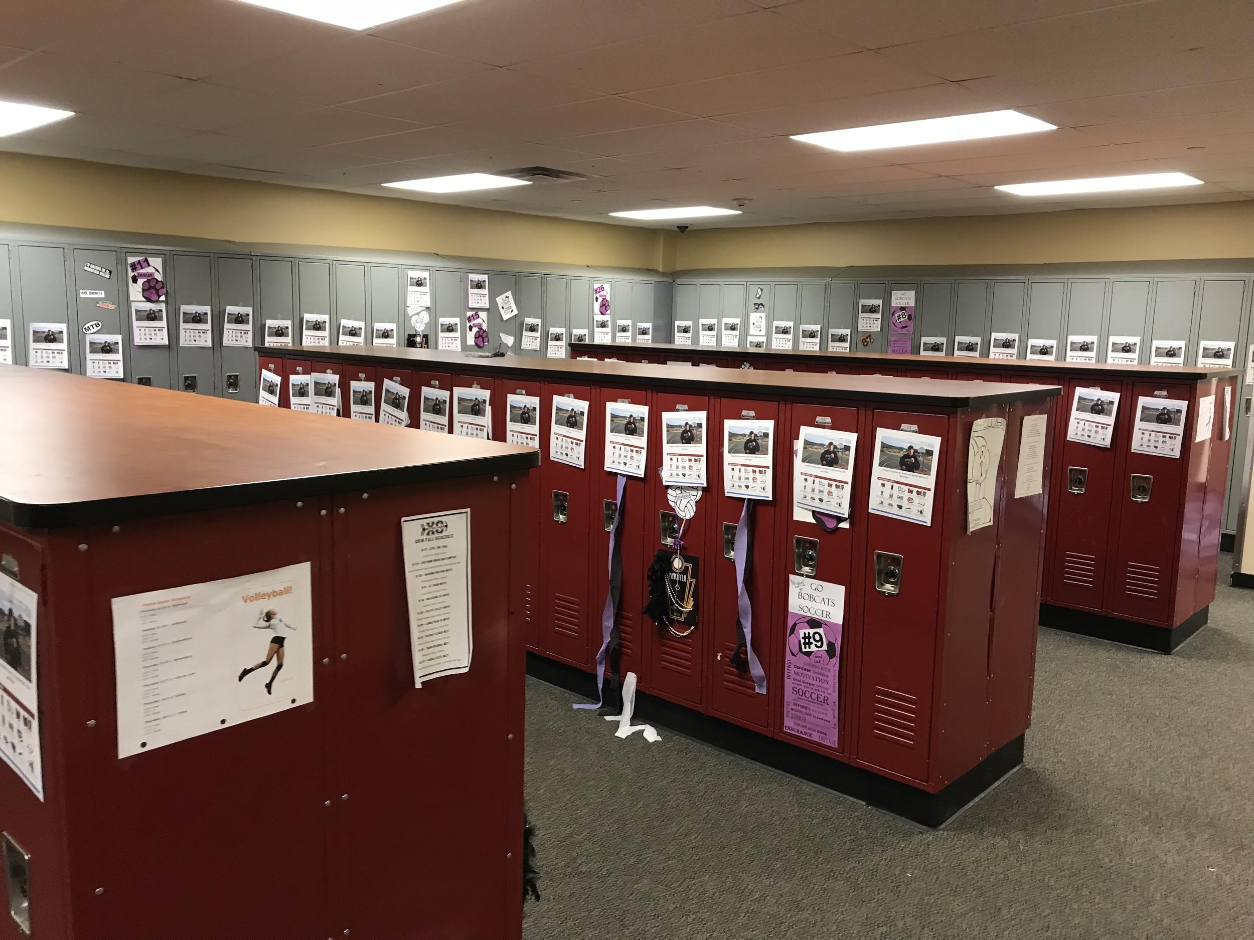
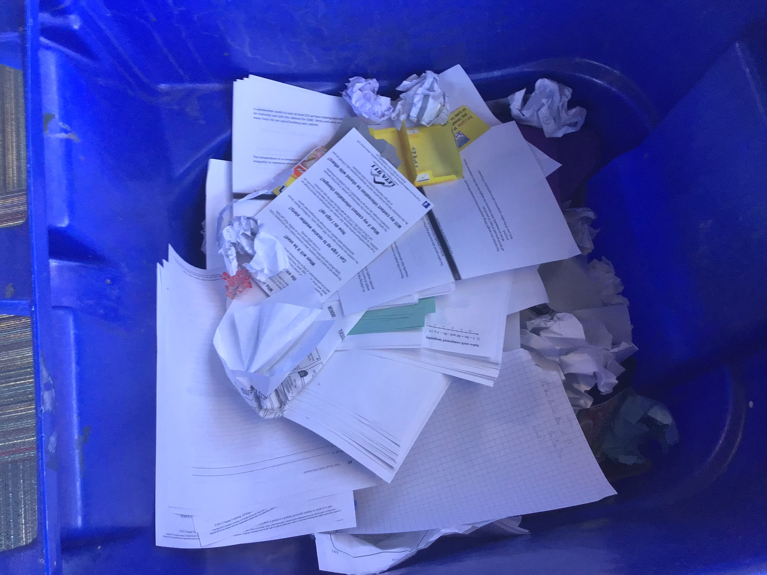
PART 5: Project Gallery
‹#›
Notes:
‹#›

Slide 13
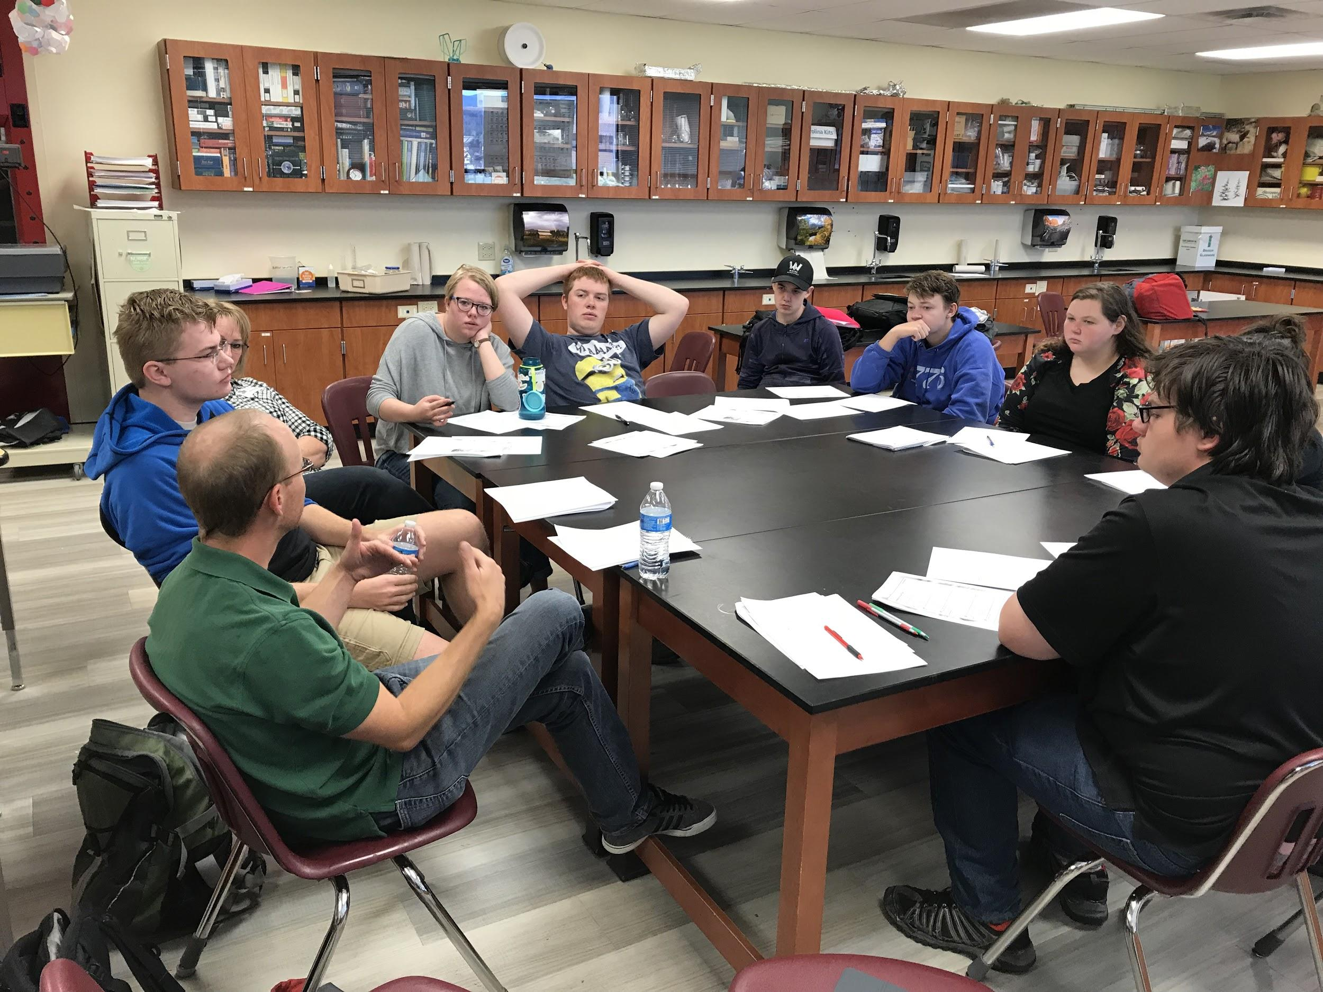
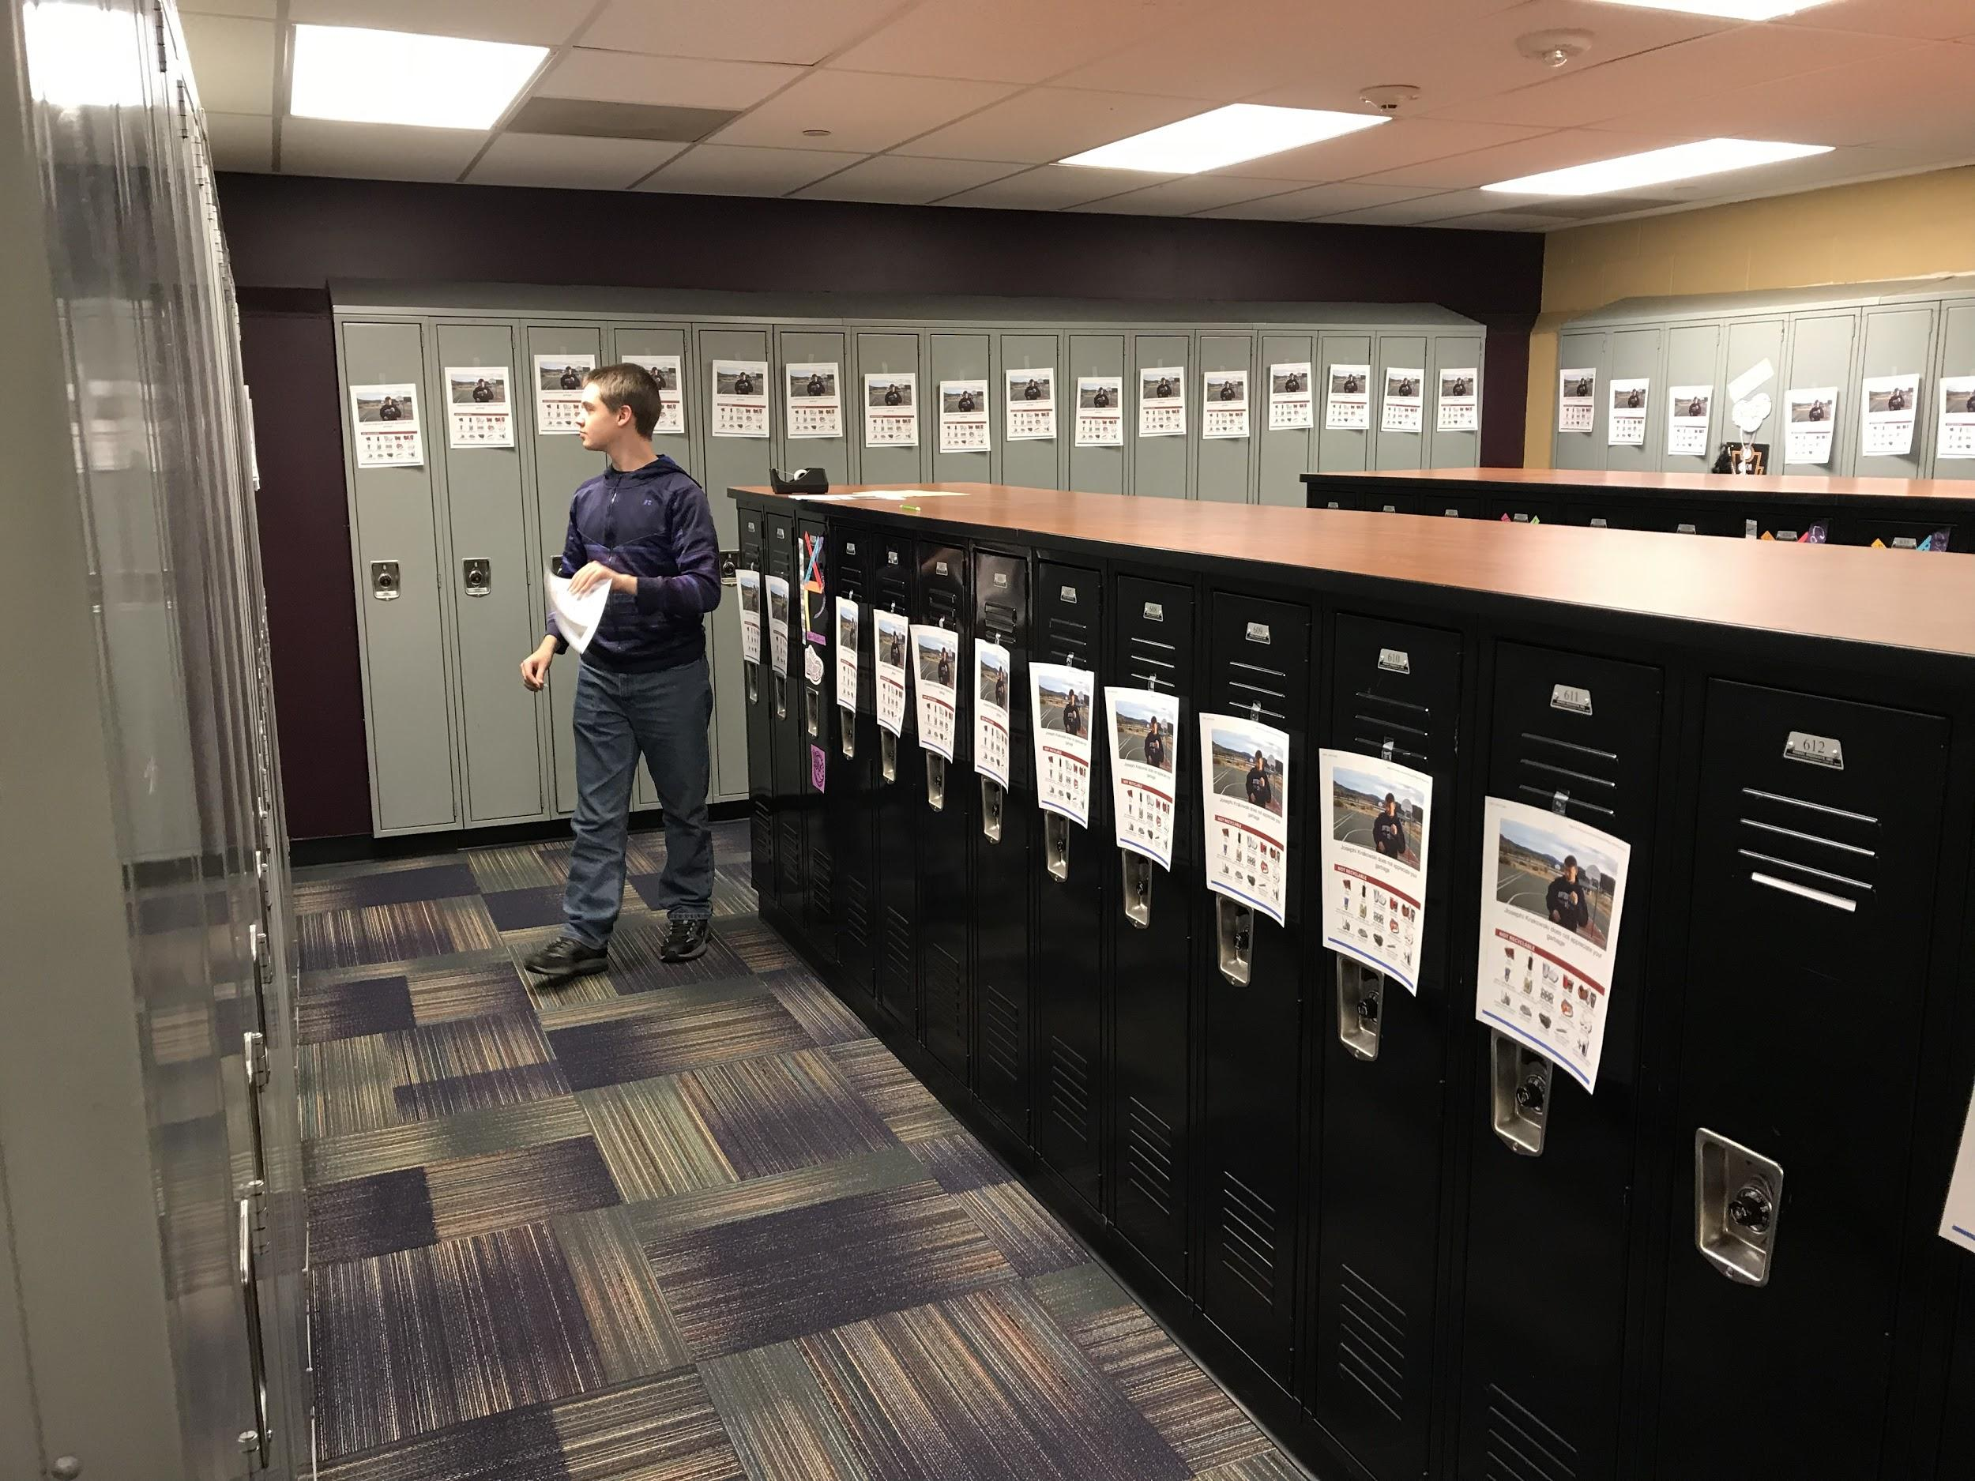
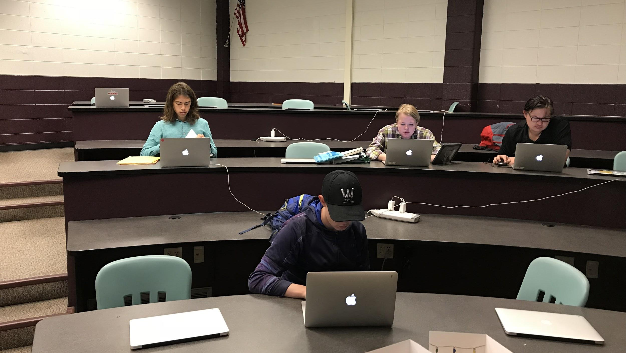
PART 5: Project Gallery
‹#›
Notes:
‹#›

Slide 14
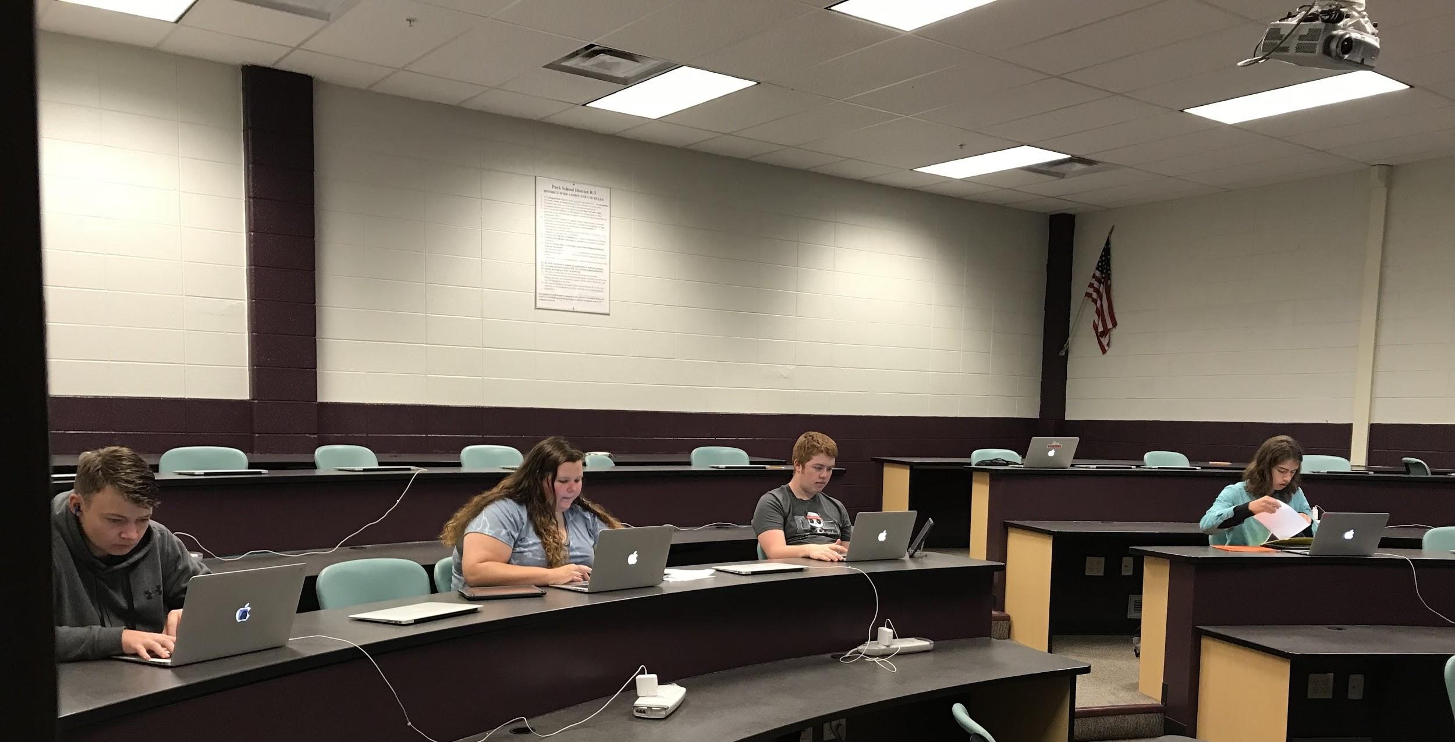
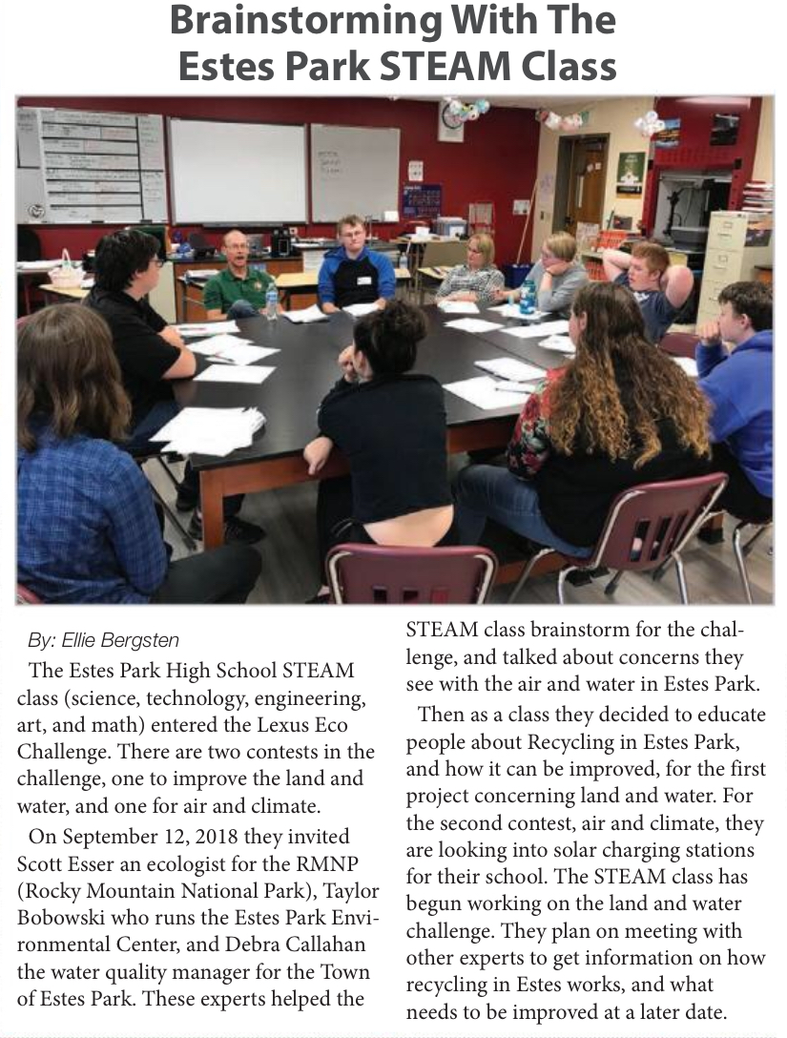
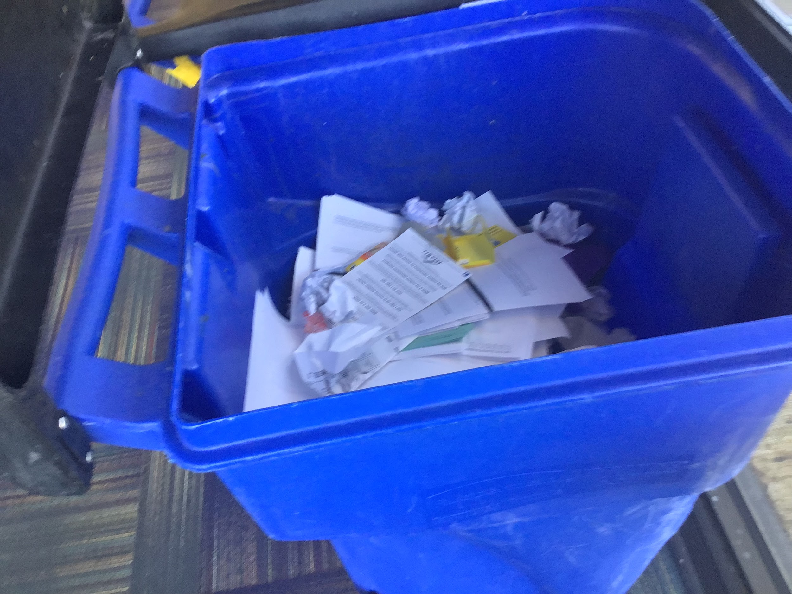
PART 5: Project Gallery (continued)
‹#›
Notes:
‹#›

