Slide 1
Today’s “Plan”—Monday August 21, 2023 6th Grade
Attendance/Seating Chart
What will you need for this class?
A-Z Activity

Slide 2
Today’s “Plan”—Tuesday August 22, 2023 STEAM
Attendance/Seating Chart/Brain Stretcher
Briefly discuss the class
What will you need for this class?
A-Z activity (not for 6th grade)
Week 1 Teach To’s
Getting Acquainted Activity
Begin constructing Keynote/Google Slide

Slide 3
S Science
T Technology
E Engineering
A Art
M Math

Slide 4
Possible STEAM Activities/Topics
Website Design
Coding
The Design Process
CAD/3-D Printing
Drones
Engineering Contests
Robotics
Entrepreneurship
Podcasts
Art
Christmas cards
Laser engraving
Spirit buttons
School Store
Content for our YouTube channel
Science Festival for elementary school

Slide 5
What will you need to be successful in this class?
Materials for this class:
Writing utensil (pen, pencil, I don’t really care!)
iPad
If asked nicely to do something (or not do something)… DO IT!
If something doesn’t pertain to you, LEAVE IT ALONE!

Slide 6
Getting Acquainted Activity
You will be interviewing your new friend (table partner). You write their answers down on your document.
When finished, place it in the “Turn In Box”

Slide 7
Today’s “Plan”—Wednesday August 23, 2023 STEAM
Attendance/Seating Chart
Questions/Reminders from yesterday
What do you need for this class—make it official!
Introductory Email
2nd pd—continue ROARS matrix
Continue Getting Acquainted Activity
Begin constructing Keynote/Google Slide
Present some “Getting Acquainted” activities

Slide 8
What will you need to be successful in this class?
Materials for this class:
Writing utensil (pen, pencil, I don’t really care!)
iPad
If asked nicely to do something (or not do something)… DO IT!
If something doesn’t pertain to you, LEAVE IT ALONE!

Slide 9
Introductory Activity
Compose an email to joe_frey@estesschools.org or joe_frey@psdr3.k12.co.us
For the subject, type “Intro STEAM Activity”
Looking at the “Possible STEAM Activities/Topics” list:
Things I have done
(List things you have experience in)
Things I would most be interested in:
(List at least 3 things you would be most interested in)
Feel free to include something that is not included on the list.
When finished answering those, hit SEND and then flip ‘em flat.

Slide 10
Today’s “Plan”—Thursday August 24, 2023 STEAM
Attendance/Brain Stretcher
Go to estesparksteam.com for the Brain Stretcher
Questions/Reminders
Continue/Finish Getting Acquainted Activity
Submit TWO assignments (see whiteboard)
Begin constructing Keynote/Google Slide
Present some “Getting Acquainted” activities
If time:
6th grade work on ROARS matrix
7th grade begin boat planning
8th grade work on spirit button designs

Slide 11
Today’s “Plan”—Freyday August 25, 2023 STEAM
Attendance/Brain Stretcher
Go to estesparksteam.com for the Brain Stretcher
Questions/Reminders
Continue/Finish Getting Acquainted Activity
Submit TWO assignments (see whiteboard)
Present some “Getting Acquainted” activities
If time:
6th grade work on ROARS matrix
7th grade begin boat planning
8th grade work on spirit button designs or begin looking up Science demonstrations

Slide 12
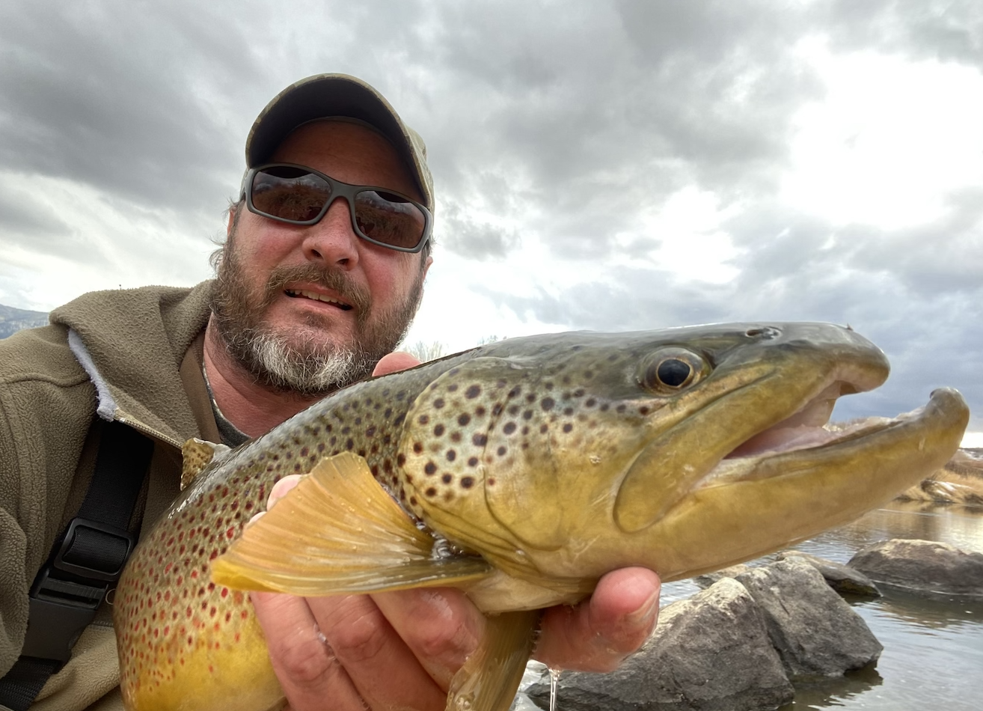
My friend is Joe Frey
His favorite hobby is fishing
Fishes over 100 days a year.
His favorite place that he has visited is Alaska
Wants to live there someday.
Something he is good at is shooting
Won a World Championship in competitive pistol shooting in 2014.
He is scared of snakes!
Had lots of snakes growing up in the Ozarks.

Slide 13
Little Shop of Physics

Slide 14
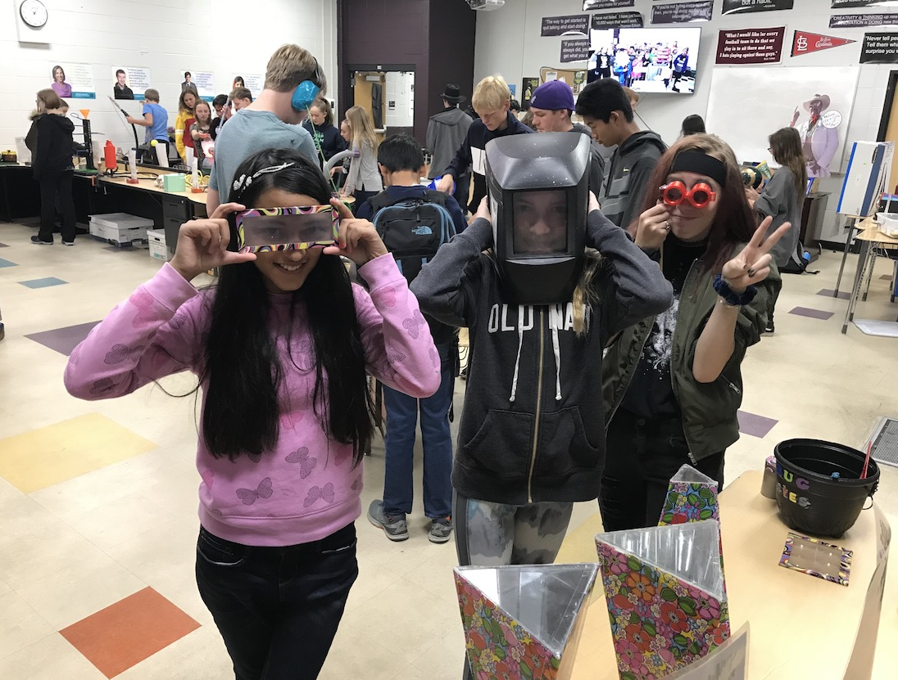

Slide 15
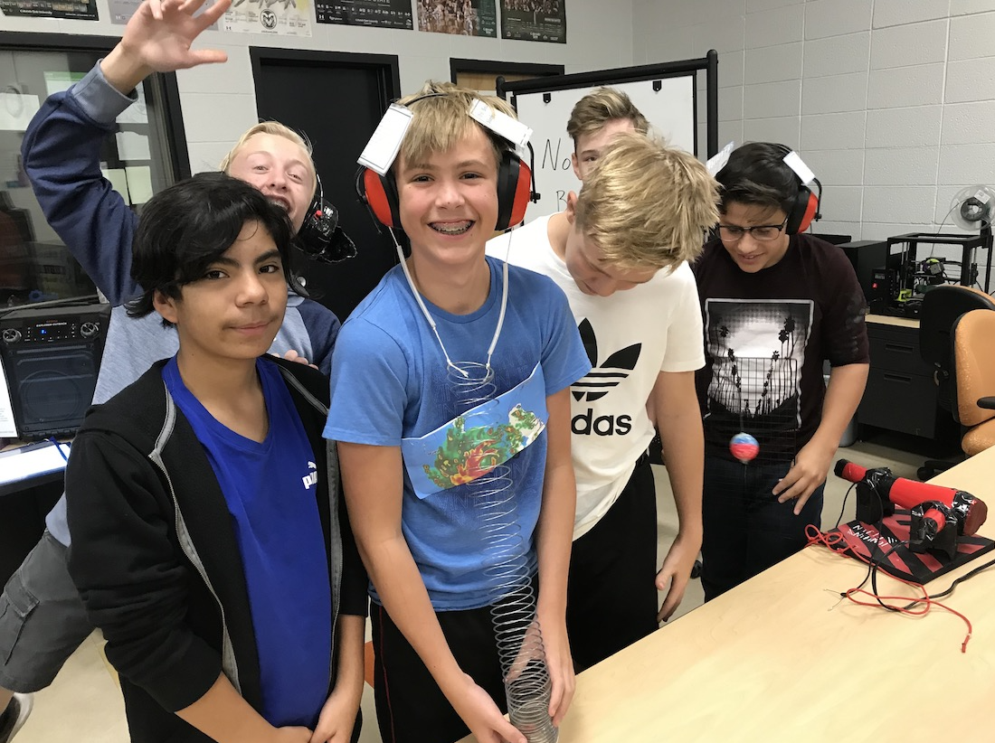

Slide 16
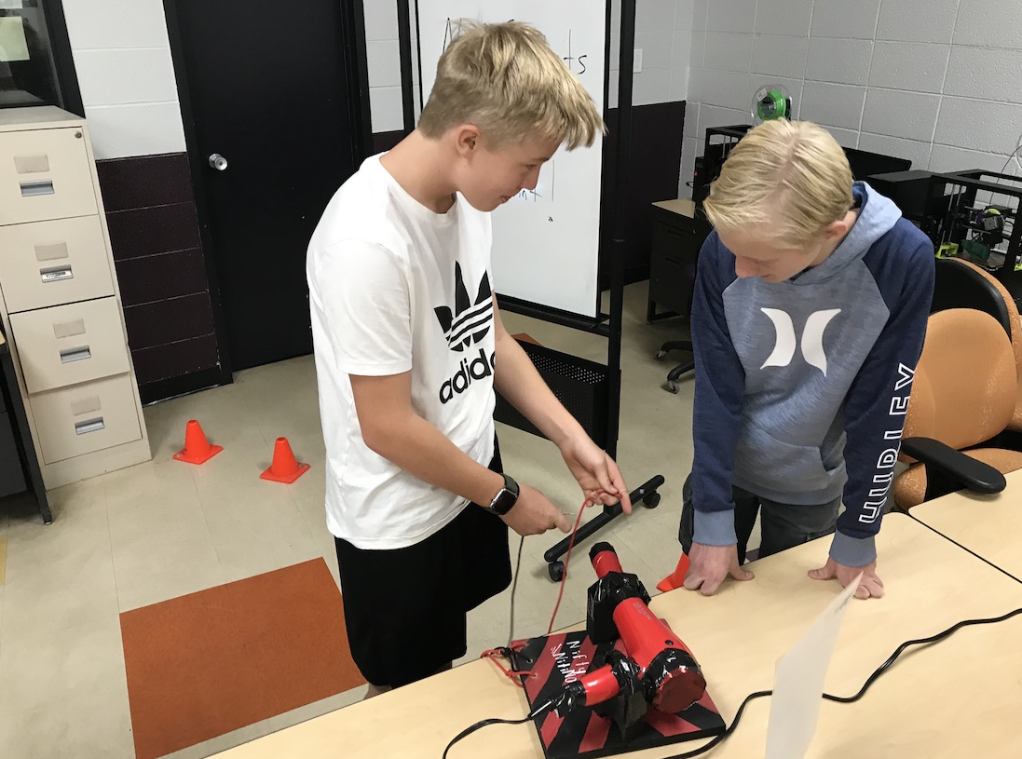

Slide 17
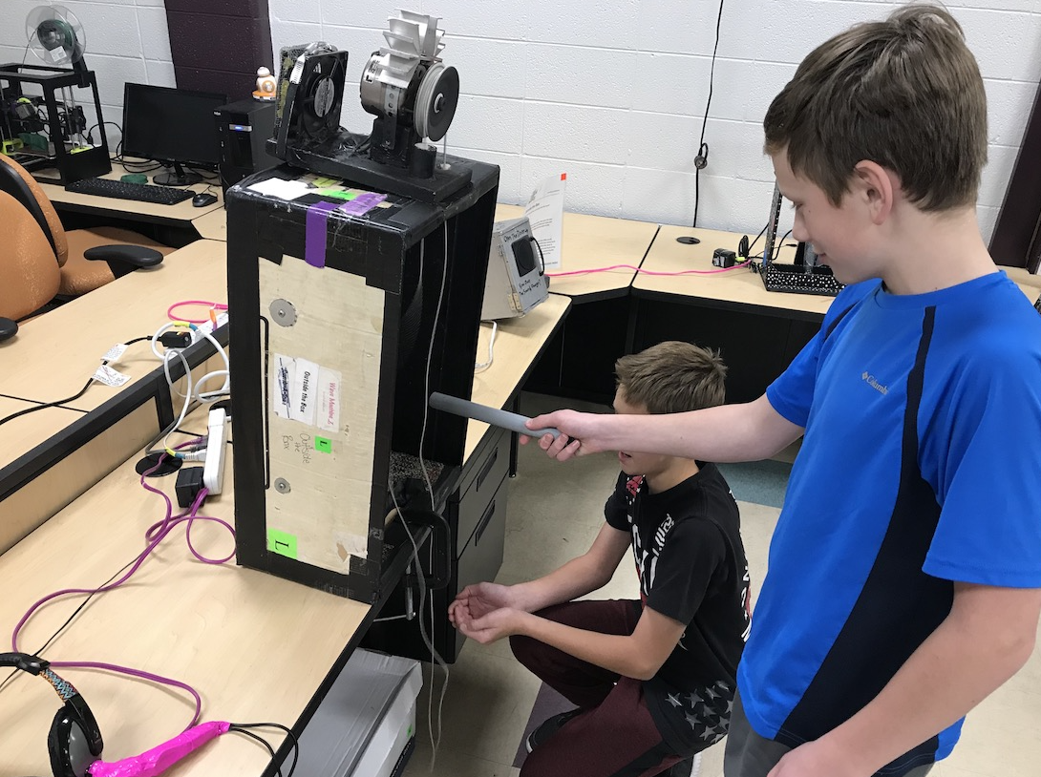

Slide 18
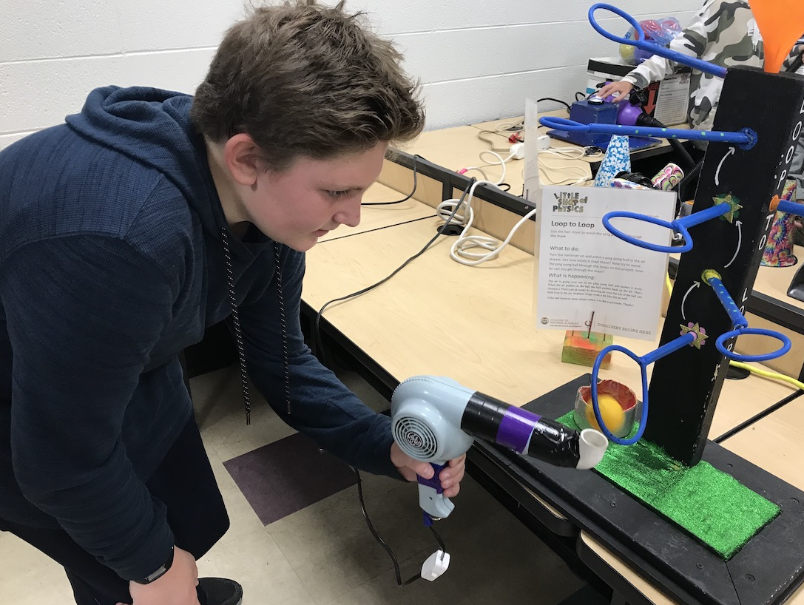

Slide 19
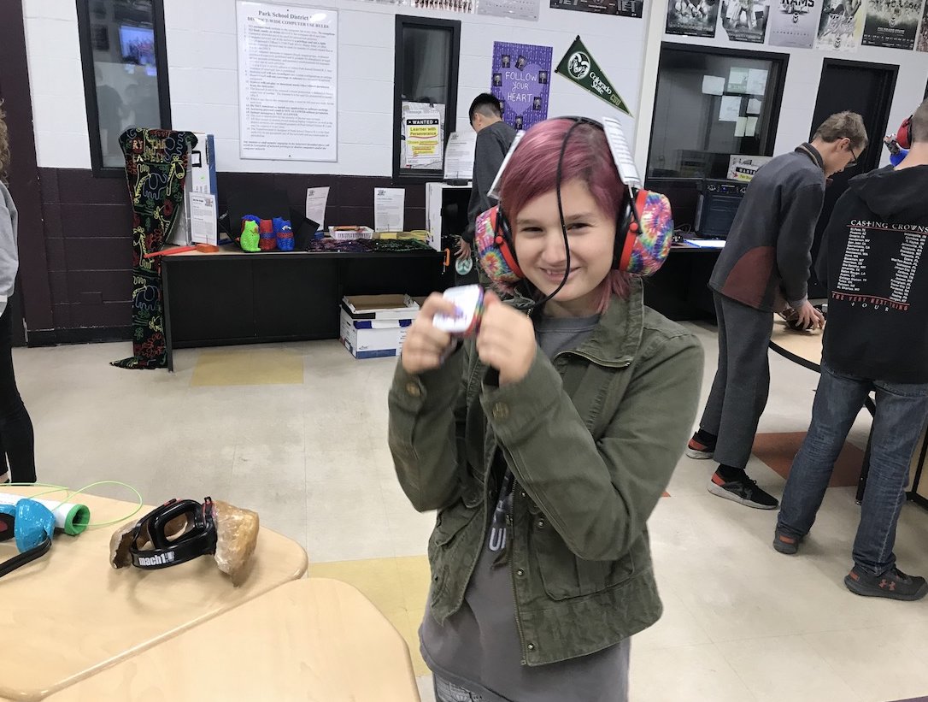

Slide 20
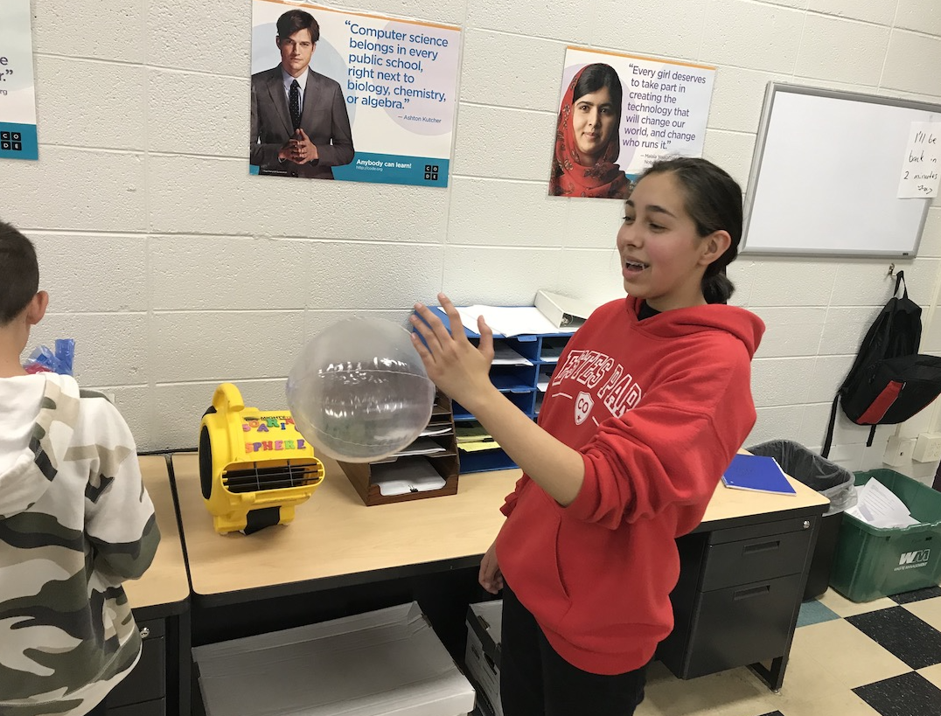

Slide 21
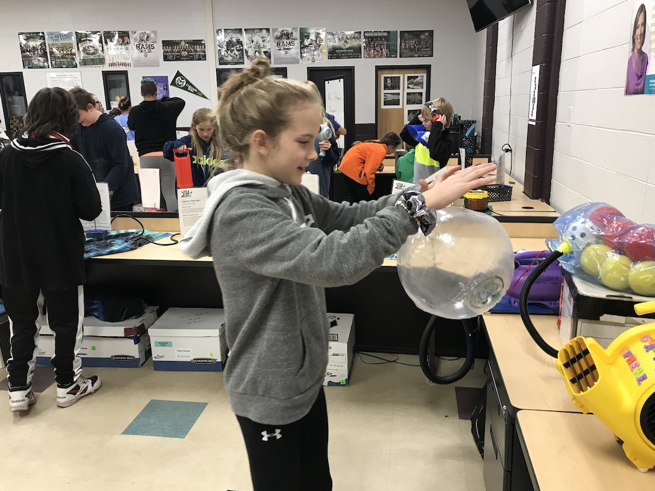

Slide 22
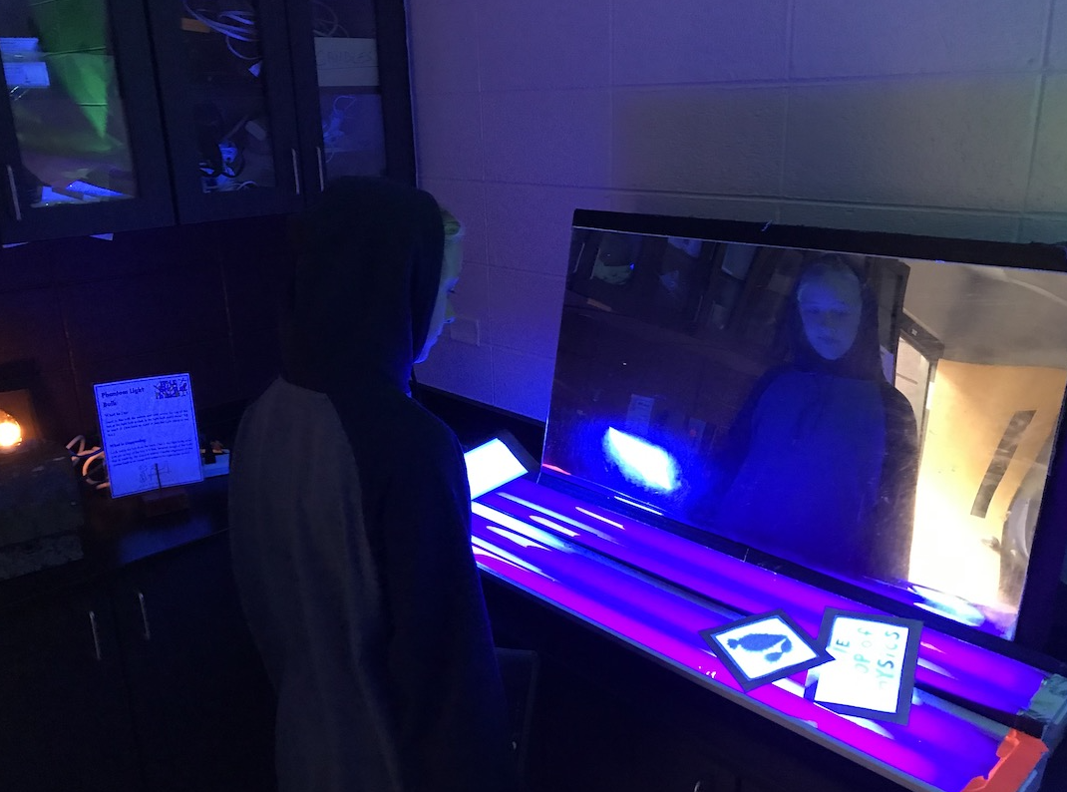

Slide 23
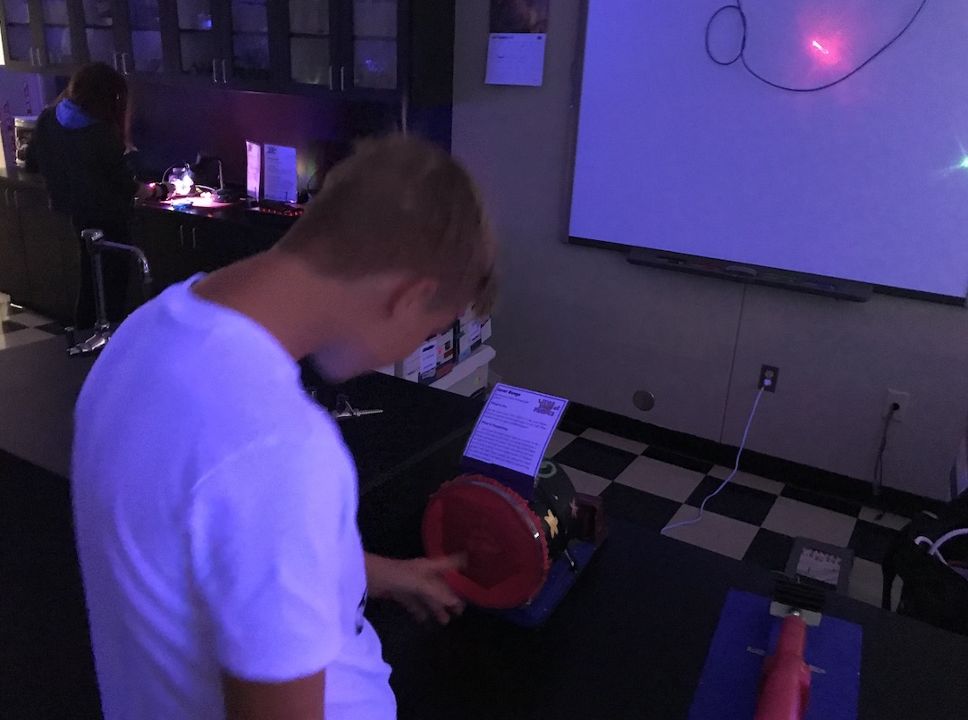

Slide 24
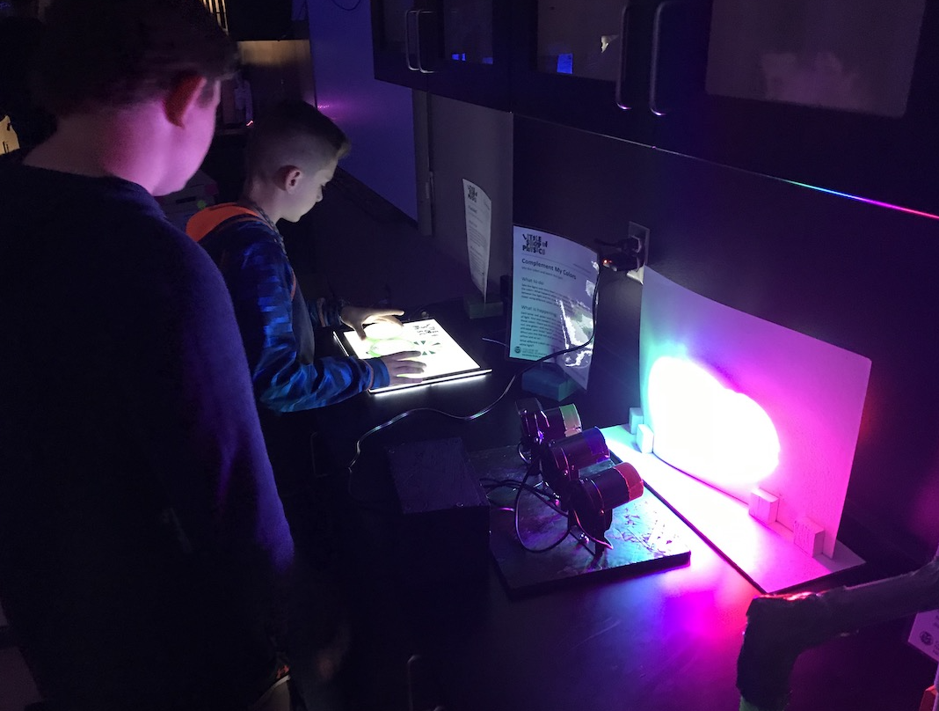

Slide 25
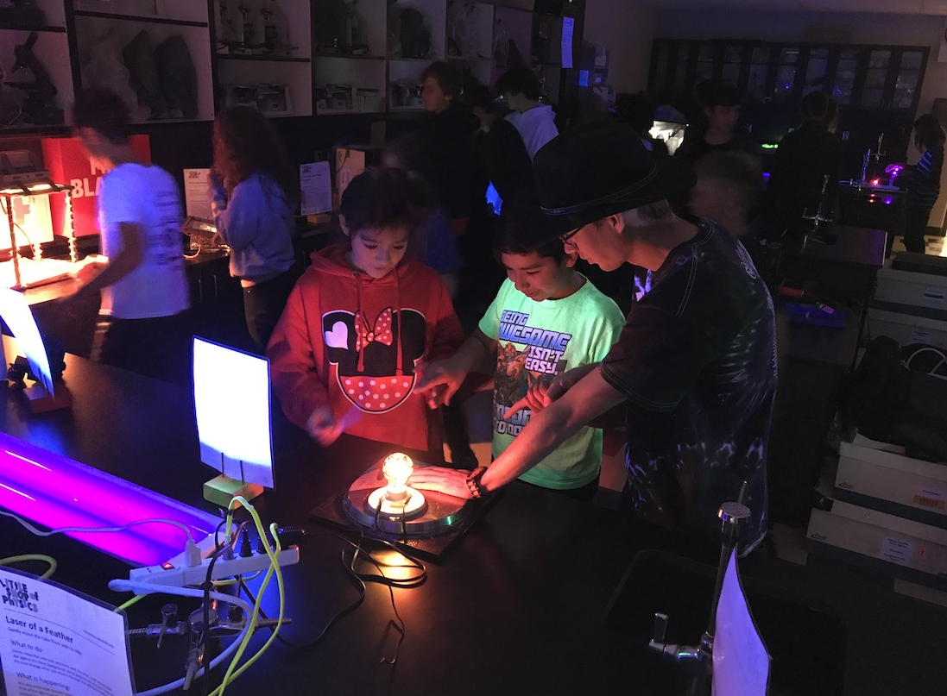

Slide 26
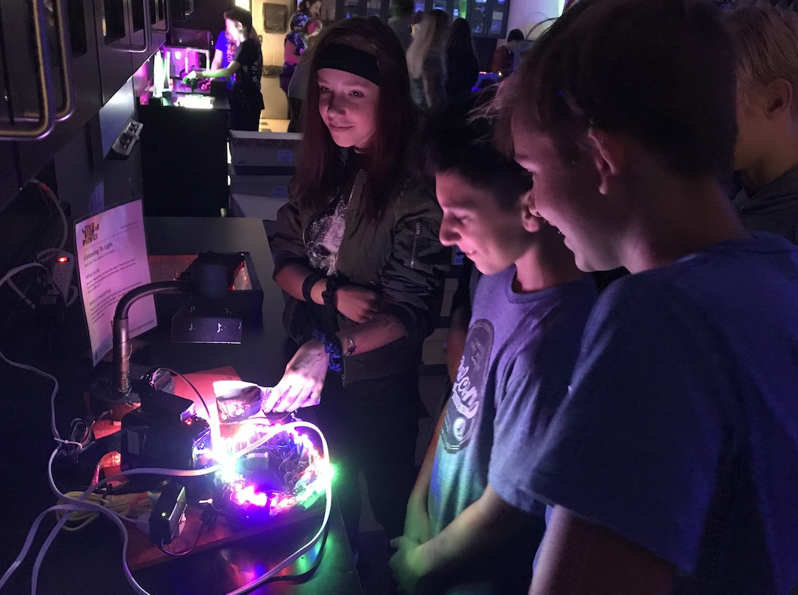

Slide 27
Little Shop of Physics

Slide 28
Today’s “Plan”—Monday August 28, 2023 STEAM
Attendance/Brain Stretcher
Make sure assignments are submitted to Schoology
Getting Acquainted Sheet
Getting Acquainted Presentation
Present some “Getting Acquainted” activities
6th grade work on ROARS matrix/begin boat planning
7th grade begin boat planning
8th grade
Show Little Shop of Physics Website through estesparksteam.com
Begin looking up Science demonstrations

Slide 29
Today’s “Plan”—Tuesday August 29, 2023 6th grade STEAM
Attendance/Brain Stretcher
Make sure assignments are submitted to Schoology
Getting Acquainted Sheet (show 6th grade how)
Getting Acquainted Presentation
Begin Boat Planning while others finish ROARS
Begin boat building once you have come up with a plan
If time, do a couple of ”Getting Acquainted” presentations
Ready to Work on Boats:
Harper D.
Harper T.
Liam
Rivers
Alex
Emily
Wyatt?

Slide 30
Boat Building Project:
Materials provided:
Aluminum foil (3’ x 1’)
10 straws
Duct Tape
Only thing you can add on own:
1 layer of cardboard for floor
Cardboard must be on the inside of the aluminum foil
Make sure and put your name on your boat!

Slide 31
ROARS
Respect
Ownership
Attentive
Responsibility
Safe
On a sheet of paper, list at least 4 ways you can demonstrate ROARS for each element of ROARS.
When finished, submit in Schoology to “ROARS”

Slide 32
Today’s “Plan”—Tuesday August 29, 2023 7th & 8th grade STEAM
Attendance/Brain Stretcher
Make sure assignments are submitted to Schoology
Getting Acquainted Sheet (6th grade)
Getting Acquainted Presentation
Present some “Getting Acquainted” activities
6th grade work on ROARS matrix/begin boat planning
7th grade begin boat building
8th grade
Show Little Shop of Physics Website through estesparksteam.com
Begin looking up Science demonstrations

Slide 33
Today’s “Plan”—Wednesday August 30, 2023 6th grade STEAM
Attendance/Brain Stretcher
Make sure assignments are submitted to Schoology
Getting Acquainted Sheet (show 6th grade how)
Getting Acquainted Presentation
Do a couple of ”Getting Acquainted” presentations
Begin Boat Planning while others finish ROARS
Begin boat building once you have come up with a plan

Slide 34
Today’s “Plan”—Wednesday August 30, 2023 7th & 8th grade STEAM
Attendance/Brain Stretcher
Make sure assignments are submitted to Schoology
Getting Acquainted Sheet (6th grade)
Getting Acquainted Presentation
Present remaining “Getting Acquainted” activities
7th grade continue boat building
8th grade
Go over Science demonstrations you found yesterday
Boats?

Slide 35
Today’s “Plan”—Thursday August 31, 2023 6th grade STEAM
Attendance/Brain Stretcher
Make sure assignments are submitted to Schoology
Getting Acquainted Sheet (show 6th grade how)
Getting Acquainted Presentation
Do a couple more ”Getting Acquainted” presentations
Reminder on boat building parameters
Continue boat building once you have come up with a plan

Slide 36
Today’s “Plan”—Thursday August 31, 2023 7th & 8th grade STEAM
Attendance/Brain Stretcher
Make sure assignments are submitted to Schoology
Getting Acquainted Sheet (6th grade)
Getting Acquainted Presentation
Present remaining “Getting Acquainted” activities
7th grade continue boat building/Begin testing
8th grade
Go over Science demonstrations you found yesterday
Boats?

Slide 37
Today’s “Plan”—Freyday September 1, 2023 6th grade STEAM
Attendance/Brain Stretcher
Make sure assignments are submitted to Schoology
Getting Acquainted Sheet (show 6th grade how)
Getting Acquainted Presentation
Do a couple more ”Getting Acquainted” presentations
Finish boat building
Begin testing boats

Slide 38
Today’s “Plan”—Freyday September 1, 2023 7th & 8th grade STEAM
Attendance/Brain Stretcher
Make sure assignments are submitted to Schoology
Getting Acquainted Sheet (6th grade)
Getting Acquainted Presentation
Present remaining “Getting Acquainted” activities
7th grade Finish boat building/Begin testing
8th grade
Build boats.

Slide 39
Boat Evaluation
What were some things you did well with your boat?
What will you do to improve your next boat?

Slide 40
Boat Building Project:
Materials provided:
Aluminum foil (3’ x 1’)
10 straws
Duct Tape
Only thing you can add on own:
1 layer of cardboard for floor
Cardboard must be on the inside of the aluminum foil
Make sure and put your name on your boat!
Don’t use cardboard until you have completed the shape of your boat!

Slide 41
Today’s “Plan”—Tuesday September 5, 2023 6th grade STEAM
Attendance/Brain Stretcher
Any more ”Getting Acquainted” presentations?
Begin testing boats
Boat Reflection

Slide 42
Today’s “Plan”—Wednesday September 6, 2023 6th grade STEAM
Attendance
Finish Boat Evaluation
2nd contest—you are now competing against yourself.
You must beat your old score.
You get the same materials as before.
No groups this time.
Prior to building your boat, you need to have a rough draft of what you are planning to do in building your 2nd boat.
Submit to Schoology, it is called “Boat Rough Draft”
Then begin constructing your boat.

Slide 43
Boat Evaluation (submit to Schoology when finished
What were some things you did well with your boat?
What would you do to improve your next boat?
This is graded on using proper writing procedures (capitalization, punctuation, complete sentences, restating the question in the sentence, etc.).
===========================================================
Prior to building your boat, you need to have a rough draft of what you are planning to do in building your 2nd boat.
Submit to Schoology, it is called “Boat Rough Draft”
Then begin constructing your boat.

Slide 44
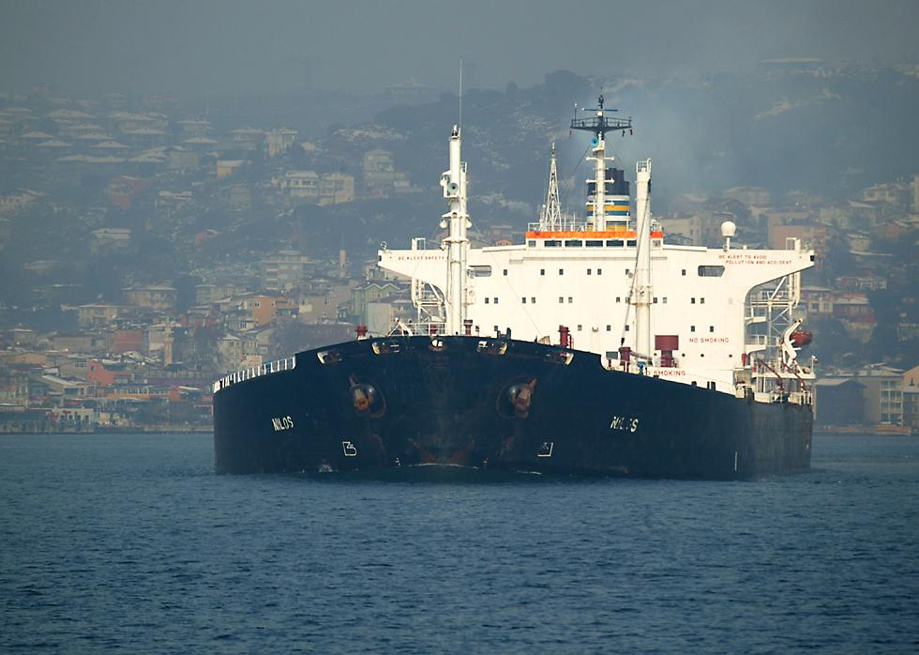
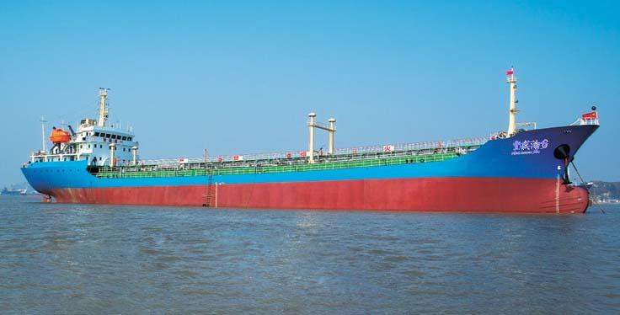
Archimedes’ Principle
Archimedes’ Principle states that the buoyant force acting on a submerged object is equal to the weight of the fluid the object displaces.

Slide 47
Buoyant Force—force of a fluid pushing up on an object to allow it to float.
ex: a floating ship
As long as the amount of water displaced by the ship
can equal the weight of the ship, it will float.

Slide 48
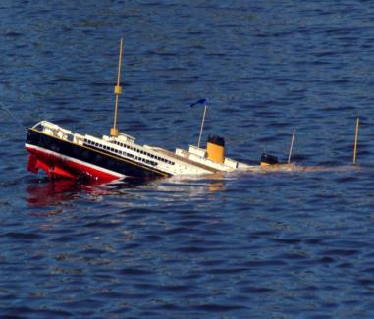
If the weight of the ship/object exceeds (is greater than) the weight of the water that it displaces, it will sink.

Slide 49
Today’s “Plan”—Wednesday September 6, 2023 7th & 8th grade STEAM
Attendance/Brain Stretcher
7th grade Finish boat redesign/Build 2nd boat
If time, begin building 2nd boat
8th grade—School Store Ideas

Slide 50
Today’s “Plan”—Thursday September 7, 2023 6th grade STEAM
Attendance/Kahoot Brain Stretcher
2nd contest—you are now competing against yourself.
You must beat your old score.
You get the same materials as before.
No groups this time.
Prior to building your boat, you need to have a rough draft of what you are planning to do in building your 2nd boat.
Submit to Schoology, it is called “Boat Rough Draft”
Then begin constructing your boat.

Slide 51
Today’s “Plan”—Thursday September 7, 2023 7th & 8th grade STEAM
Attendance
7th grade Finish boat redesign/Build 2nd boat
Sink boats!
8th grade—continue School Store Ideas
Continue School Store Planning Presentation
Construct proposal of what you/your group would like to see in our school store.
You will make a presentation which will be presented to the class.
Identify items for raffle give-a-ways & items for purchase
Research specific things you think we want to purchase (and the cost), where we would order from, etc.
Why would those be good items?

Slide 52
Today’s “Plan”—Freyday September 8, 2023 6th grade STEAM
Attendance/Brain Stretcher
2nd contest—you are now competing against yourself.
You must beat your old score.
You get the same materials as before.
No groups this time.
Test boats!
Learning Target:
What are some qualities that make for a good boat design to hold the most weight?

Slide 53
Today’s “Plan”—Freyday September 8, 2023 7th grade STEAM
Attendance/Brain Stretcher
Lela’s boat results
Give a few minutes to finish up boats
Sink the rest of the boats!
If time, Kahoot at end.
Learning Target:
What are some qualities that make for a good boat design to hold the most weight?

Slide 54
Today’s “Plan”—Freyday September 8, 2023 8th grade STEAM
Attendance/Brain Stretcher
Science & STEAM Kahoot
Continue School Store Planning Presentation
Construct proposal of what you/your group would like to see in our school store.
You will make a presentation which will be presented to the class.
Identify items for raffle give-a-ways & items for purchase
Research specific things you think we want to purchase (and the cost), where we would order from, etc.
Why would those be good items?
Learning Target:
What are some items that would be good to sell in our School Store?

Slide 55
What Are Things We Might Want in our School Store?
Things to get from raffle tickets
Things to sell (we make $$$)

Slide 56
Today’s “Plan”—Monday September 11, 2023 6th grade STEAM
Attendance/Brain Stretcher
2nd contest—you are now competing against yourself.
You must beat your old score.
You get the same materials as before.
No groups this time.
Finishing testing boats!
Reflection on qualities that improved our boat designs.
Learning Target:
What are some qualities that improved our boat designs?

Slide 57
Today’s “Plan”—Monday September 11, 2023 7th grade STEAM
Attendance/Brain Stretcher
2nd contest—you are now competing against yourself.
You must beat your old score.
You get the same materials as before.
No groups this time.
Finishing testing boats!
Begin showing Google Sheet for collecting data.
Learning Target:
What are some qualities that improved our boat designs?

Slide 58
Today’s “Plan”—Monday September 11, 2023 8th grade STEAM
Attendance/Brain Stretcher
Finish School Store Planning Presentation
Construct proposal of what you/your group would like to see in our school store.
You will make a presentation which will be presented to the class.
Identify items for raffle give-a-ways & items for purchase
Research specific things you think we want to purchase (and the cost), where we would order from, etc.
Why would those be good items?
Learning Target:
What are some items that would be good to sell in our School Store?

Slide 59
Today’s “Plan”—Tuesday September 12, 2023 6th grade STEAM
Attendance/Brain Stretcher
Finishing testing boats!
Paragraph on qualities that improved our boat designs.
If time, start using Google Sheets for data collection.
Learning Target:
What are some qualities that improved our boat designs?

Slide 60
Today’s “Plan”—Tuesday September 12, 2023 7th grade STEAM
Attendance/Brain Stretcher
Paragraph on qualities that improved our boat designs.
Google Sheets for collecting data.
Learning Target:
What are some qualities that improved our boat designs?

Slide 61
Boat Paragraph
This should be written in paragraph form, using proper writing procedures.
Remember: indent, capitalization, punctuation, restate the question in the sentences.
Topic/Introductory sentence
Detail sentences
Conclusion sentence
Learning Target:
What are some qualities that improved our boat designs?

Slide 62
Boat Paragraph
We saw some very good improvement in our boat designs between the first and second boats. One thing that led to better performance was ___________________________
________________________. Another improvement that allowed our boats to hold more weight was ____________
____________________________. One last thing that improved our boats was ____________________________
__________________________. These design improvements led to some great increases in how much weight our boats held.
Learning Target:
What are some qualities that improved our boat designs?

Slide 63
Today’s “Plan”—Tuesday September 12, 2023 8th grade STEAM
Attendance/Brain Stretcher
School Store Planning Presentations
As groups go, audience will jot down some of the products they think are best products.
Narrow down which products we will actually sell.
Learning Target:
What are some items that would be good to sell in our School Store?

Slide 64
Today’s “Plan”—Wednesday September 13, 2023 6th & 7th grade STEAM
Attendance/Innovators Brain Stretcher later in class
Reflect on boat engineering process
7th grade—finish Google Sheets data
Introductory Kahoot over Innovators
Begin the Design Process
Video: https://www.youtube.com/watch?v=fxJWin195kU
Designing a better backpack
Learning Target:
How do engineers go about creating new ideas and items?

Slide 65
The Design Process
Define Problem
Research
Develop Possible Solutions (Brainstorm ideas)
Develop a Solution
Build a Prototype
Test
Evaluate
Learning Target:
How do engineers go about creating new ideas and items?

Slide 66
The Design Process Designing a Better Backpack
You are given the task of creating a better backpack.
Who is going to be your target audience?
What is the purpose of this backpack?
School? Sports? Business person? Hiker? Camper? Hunter? Fisherman? Pet owner? Etc.........
Your Task (write this on a sheet of paper—no iPads!):
Write down what type of backpack you are going to design (specific purpose or specific use?)
Brainstorm a list of at LEAST 25 things you want in a better backpack.
Learning Target:
How do engineers go about creating new ideas and innovations?

Slide 67
Today’s “Plan”—Thursday September 14, 2023 6th & 7th grade STEAM
Attendance
Continue brainstorming ideas for designing a better backpack
Explain the entire process we will be going through on this project.
Video: Making a pitch
Work on Selling Points
Learning Target:
How do engineers go about creating new ideas and items?

Slide 68
The Design Process
Define Problem
Research
Develop Possible Solutions (Brainstorm ideas)
Develop a Solution
Build a Prototype
Test
Evaluate
Learning Target:
How do engineers go about creating new ideas and items?

Slide 69
The Design Process Designing a Better Backpack
You are given the task of creating a better backpack.
Who is going to be your target audience?
What is the purpose of this backpack?
School? Sports? Business person? Hiker? Camper? Hunter? Fisherman? Pet owner? Etc.........
Your Task (write this on a sheet of paper—no iPads!):
Write down what type of backpack you are going to design (specific purpose or specific use?)
Brainstorm a list of at LEAST 20 things you want in a better backpack.
Learning Target:
How do engineers go about creating new ideas and innovations?

Slide 70
STEAM I: The Design Process Designing a Product or Improving a Product
Your task (on paper/no iPads for this):
Brainstorm a list of possible ideas—have at least 20.
Take a picture of that sheet, submit that to Schoology; it is called ”Brainstorming List”.
Now start identifying what are going to be the key “selling points” about your product. What is going to make your product unique? What about it is going to be appealing to other people?
In the end, you will need:
Product description
Name for product/company
Logo for your product

Slide 71
Today’s “Plan”—Freyday September 15, 2023 6th & 7th grade STEAM
Attendance
Logo Activity: Name the Logo
What do you think are some of the all-time most famous/well-known logos?
Video: Top 10 Logos
Discuss types of Logos
Next steps:
Name for product/company
Logo for your product
Product description
Learning Target:
What purpose do logos serve, and what main types of logos are there?

Slide 72
Logo Activity
With your table partner, number a sheet of paper from #1-35.
Don’t skip lines
Make 2 columns all the numbers fit on one page.
You will see a sheet of 35 logos.
Most of the logo is featured, but certain parts are crossed out or missing.
The logos go in order from left to right.
Name as many logos as you can.
Open one iPad at your table
Make sure all unnecessary apps/websites are closed out.
Go to estesparksteam.com
Click on “STEAM” button
Open “Logos” pdf... and GO!
Learning Target:
What purpose do logos serve, and what main types of logos are there?

Slide 74
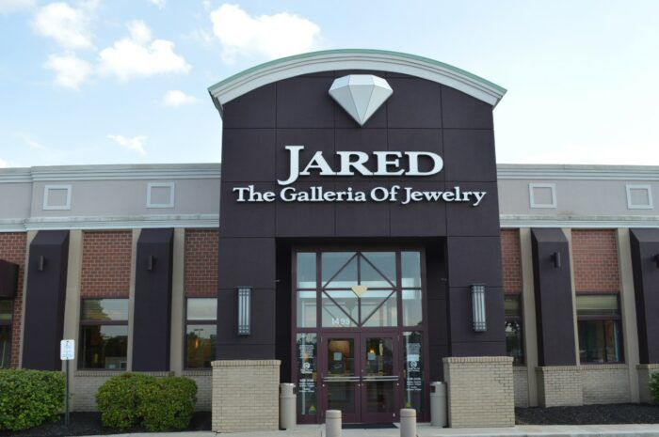

Slide 76
Today’s “Plan”—Freyday September 15, 2023 6th & 7th grade STEAM
Attendance
Logo Activity: Name the Logo
What do you think are some of the all-time most famous/well-known logos?
Video: Top 10 Logos
Discuss types of Logos
Next steps:
Name for product/company
Logo for your product
Product description
Learning Target:
What purpose do logos serve, and what main types of logos are there?

Slide 77
Today’s “Plan”—Wednesday September 13, 2023 8th grade STEAM
Attendance
Options for Today:
Create button designs
Soccer, volleyball, cross country, football, swimming.
Create new school “Thank You” card
By yourself or in partners, begin looking up items for purchase for our School Store
Learning Target:
Creation of STEAM products (button designs, Thank You cards or
What are some of the best deals we can get for School Store items?

Slide 78
Today’s “Plan”—Thursday September 14, 2023 8th grade STEAM
Attendance
Continued Options for Today:
Create button designs
Soccer, volleyball, cross country, football, swimming.
Create new school “Thank You” card
By yourself or in partners, begin looking up items for purchase for our School Store
Continued planning for Science Festival
Learning Target:
Creation of STEAM products (button designs, Thank You cards or
What are some of the best deals we can get for School Store items?

Slide 79
Looking up items for School Store:
Can do by yourself or with a partner (no more than groups of 2).
Select a couple of different items to look up
For example, choose customized pencils and rubber bracelets
Then we want at least 3 different sources for each item.
We are looking for:
Best price/Best deal (how much per item)
Does it look like a decent quality item?
Is this something our students would want/buy?
Look at the reviews (if available)
Are there added costs (such as shipping)?
Create some sort of document which compares each of the 3 sources for each product; we will then narrow down our purchasing from those three suggestions.
Artists:
If not working on the School Store research, then be working on designs to create for our buttons, or a new school Thank You card.
Sports going on right now include soccer, volleyball, cross country, football, swimming. Can do other clubs or upcoming activities.
Learning Target:
Creation of STEAM products (button designs, Thank You cards or
What are some of the best deals we can get for School Store items?

Slide 80
Items We Want to Look Up:
Personalized pencils (wooden)
Mechanical pencils
Pens
Pens with Stylus
Stickers
Key Chains
Water bottles
Mugs
Drawstring bags
Beaded necklaces
Lanyards
Choose a couple of these to research and write your name on the board.
Learning Target:
Creation of STEAM products (button designs, Thank You cards or
What are some of the best deals we can get for School Store items?

Slide 81
Today’s “Plan”—Freyday September 15, 2023 8th grade STEAM
Attendance
Hand out “Science Festival Planning Sheet #2”
Continued planning for Science Festival
You will turn this sheet in at the end. It should be DETAILED! Put it in the “Turn in Box”
Turn in the document about your description to Schoology
Learning Target:
What are some specific things we will need and do for our Science Festival project?

Slide 82
Today’s “Plan”—Monday September 18, 2023 6th & 7th grade STEAM
Attendance/Kahoot Brain Stretcher
Discuss types of Logos
Next steps:
Name for product/company
Logo for your product
Product description
Learning Target:
What purpose do logos serve, and what main types of logos are there?

Slide 86
Today’s “Plan”—Wednesday September 20, 2023 6th & 7th grade STEAM
Attendance
Was anybody gone yesterday?
Schoology Quiz: Myth Busters Quiz
There should be absolutely no talking during a quiz/test.
Use your sheet from yesterday to help you.
Top Inventions of All Time
Next steps:
Name for product/company
Logo for your product
Product description/Writing out your script.
Learning Target:
What purpose do logos serve, and what main types of logos are there?

Slide 87
Today’s “Plan”—Wednesday September 20, 2023 8th grade STEAM
Attendance
Was anybody gone yesterday?
Schoology Quiz: Myth Busters Quiz
There should be absolutely no talking during a quiz/test.
Use your sheet from yesterday to help you.
Begin planning 1st demonstration
What are you planning on doing?
What do you need?
Finish buttons, cards, or looking up prices
Will make buttons on Friday
Learning Target:
What are some specific things we will need and do for our Science Festival project?

Slide 88
Today’s “Plan”—Thursday September 21, 2023 6th grade STEAM
Attendance/Brain Stretcher
From yesterday--Top Inventions of All Time—see who won!
Discuss making pitches
Video: Top Shark Tank Pitches
Missing assignments
Next steps:
Name for product/company
Logo for your product
Product description
Begin writing out your Script
Learning Target:
What purpose do logos serve, and what main types of logos are there?

Slide 89
Today’s “Plan”—Thursday September 21, 2023 7th & 8th grade STEAM
Learning Target:
How does the power company work to get electricity into our homes?
Attendance
Electricity Demonstration
If time:
Brain Stretcher
Button designs for 8th grade, discuss more on pitches with 7th grade.

Slide 90
Today’s “Plan”—Freyday September 22, 2023 6th grade STEAM
Attendance
Electricity Demonstration
Norms/Expectations
If time:
Brain Stretcher
Kahoot Review (didn’t get to the Kahoot)
Learning Target:
How does the power company work to get electricity into our homes?

Slide 91
Today’s “Plan”—Freyday September 22, 2023 7th & 8th grade STEAM
Learning Target:
How does the power company work to get electricity into our homes?
Attendance/Brain Stretcher
Electricity Demonstration from yesterday
Kahoot Review
7th Grade next steps:
Name for product/company
Logo for your product
Product description
Begin writing out your Script
8th Grade: Buttons, Cards, or prices

Slide 92
Today’s “Plan”—Monday September 25, 2023 6th & 7th grade STEAM
Attendance
Video: Worst Company Failures
Next steps:
Name for product/company
Logo for your product
Product description (short paragraph highlighting the key “selling points” of your product
What makes your product different from others?
Why am I going to choose your product over others?
Begin writing out your Script
Learning Target:
What am I going to focus on in promoting my product?

Slide 93
Today’s “Plan”—Monday September 25, 2023 8th grade STEAM
Attendance
Video: Understanding Car Crashes
Begin planning Egg Drop
Learning Target:
What are some characteristics you are going to put into your egg drop?

Slide 94
Egg Drop
Device holding egg cannot be bigger than 1’ x 1’ x 1’
Can use any materials except:
Helium filled balloons
Any motors or propulsion devices
Any heat source
Can have parachutes.
Must be able to put egg in/take out.
Frey will give you the egg.
You are providing the materials, so think about things you have around your house.
Everybody is on their own—no partners.
Egg Drop Planning:
Don’t look ideas up on the Internet!
Create a list of materials
Have a sketch of what your device will look like.
Write a paragraph about which materials you are using, how you are using them, and why this will be successful.
Submit to Egg Drop Planning on Schoology.

Slide 95
Today’s “Plan”—Tuesday September 26, 2023 6th & 7th grade STEAM
Attendance/Brain Stretcher
Video: How to Write a Video Script
Video: Billy Mays Examples
Next steps:
Logo for your product
Product description (short paragraph highlighting the key “selling points” of your product)
What makes your product different from others?
Why am I going to choose your product over others?
Begin writing out your Script
Learning Target:
What are the steps to use in writing a successful script for my pitch?

Slide 96
4 Steps To Writing a Script for your Pitch
Hook
How are you going to “grab” your audience?
First few seconds is all you have to keep people engaged.
Introduction
Who are you?
What is your product and why is it significant?
Body
Now you get into the details about your product.
This is where you explain your key selling points.
Call to Action
Give them a reason to act NOW.
“Order now, and receive a 2nd one absolutely free!”
“Order now, and receive a 25% student discount!”
Learning Target:
What are the steps to use in writing a successful script for my pitch?

Slide 97
Today’s “Plan”—Tuesday September 26, 2023 6th & 7th grade STEAM
Next steps:
Product description (short paragraph highlighting the key “selling points” of your product—have at least 4)
What makes your product different from others?
Why am I going to choose your product over others?
Begin writing out your Script
Hook
Introduction
Body
Call to Action
Learning Target:
What are the steps to use in writing a successful script for my pitch?

Slide 98
Today’s “Plan”—Tuesday September 26, 2023 8th grade STEAM
Attendance/Brain Stretcher
Egg Drop Planning
Drones
Check for the ”Tello” app and “Drone Blocks”
What are some uses for drones?
Learning Target:
What are some characteristics you are going to put into your egg drop?

Slide 99
Today’s “Plan”—Wednesday September 27, 2023 6th & 7th grade STEAM
Attendance
Video: Top 10 ”As Seen on TV” products
Video: Billy Mays Examples
Next steps:
Product description (short paragraph highlighting the key “selling points” of your product)
What makes your product different from others?
Why am I going to choose your product over others?
Write out your Script
Finish logo
Put together presentation slide show
Learning Target:
What are the steps to use in writing a successful script for my pitch?

Slide 100
4 Steps To Writing a Script for your Pitch
Hook
How are you going to “grab” your audience?
First few seconds is all you have to keep people engaged.
Introduction
Who are you?
What is your product and why is it significant?
Body
Now you get into the details about your product.
This is where you explain your key selling points.
Call to Action
Give them a reason to act NOW.
“Order now, and receive a 2nd one absolutely free!”
“Order now, and receive a 25% student discount!”
Learning Target:
What are the steps to use in writing a successful script for my pitch?

Slide 101
Today’s “Plan”—Wednesday September 27, 2023 6th & 7th grade STEAM
Next steps:
Product description (short paragraph highlighting the key “selling points” of your product—have at least 4)
What makes your product different from others?
Why am I going to choose your product over others?
Write out your Script
Hook
Introduction
Body
Call to Action
Finish logo
Put together slide show presentation.
Submit it to Backpack Presentation.
Learning Target:
What are the steps to use in writing a successful script for my pitch?

Slide 102
Today’s “Plan”—Wednesday September 27, 2023 8th grade STEAM
Attendance/Brain Stretcher
Egg Drop & Demonstration Planning
We will do the Egg Drop on Tuesday
Drones
What are some uses for drones?
Learning Target:
What are some characteristics you are going to put into your egg drop?

Slide 103
Today’s “Plan”—Thursday September 28, 2023 6th & 7th grade STEAM
Attendance/Brain Stretcher
Video: 15 Accidental Inventions
Video: Another Billy Mays Example
Putting things in as missing
Is anyone ready to present their pitch?
Next steps:
Product description (short paragraph highlighting the key “selling points” of your product)
Write out your Script
Finish logo
Put together Backpack Presentation slide show to go along with your pitch
Learning Target:
How am I going to best pitch my product idea?

Slide 104
4 Steps To Writing a Script for your Pitch
Hook
How are you going to “grab” your audience?
First few seconds is all you have to keep people engaged.
Introduction
Who are you?
What is your product and why is it significant?
Body
Now you get into the details about your product.
This is where you explain your key selling points.
Call to Action
Give them a reason to act NOW.
“Order now, and receive a 2nd one absolutely free!”
“Order now, and receive a 25% student discount!”
Learning Target:
What are the steps to use in writing a successful script for my pitch?

Slide 105
Today’s “Plan”—Thursday September 28, 2023 6th & 7th grade STEAM
Next steps:
Product description (short paragraph highlighting the key “selling points” of your product—have at least 4)
What makes your product different from others?
Why am I going to choose your product over others?
Write out your Script
Hook
Introduction
Body
Call to Action
Finish logo
Put together slide show presentation.
Submit it to Backpack Presentation.
Learning Target:
What are the steps to use in writing a successful script for my pitch?

Slide 106
Today’s “Plan”—Freyday September 29, 2023 6th & 7th grade STEAM
Attendance
Who is ready to present?
Do some presentations.
With remaining time, people who are not finished with presentations need to get those done!
Learning Target:
Can I demonstrate good communications skills to present my backpack idea?

Slide 107
Today’s “Plan”—Freyday September 29, 2023 6th & 7th grade STEAM
Next steps:
Product description (short paragraph highlighting the key “selling points” of your product—have at least 4)
What makes your product different from others?
Why am I going to choose your product over others?
Write out your Script
Hook
Introduction
Body
Call to Action
Finish logo
Put together slide show presentation.
Submit it to Backpack Presentation.
Learning Target:
Can I demonstrate good communications skills to present my backpack idea?

Slide 108
Today’s “Plan”—Freyday September 29, 2023 8th grade STEAM
Attendance/4th pd—Do NOT bring water bottles to class if it doesn’t have a screw on lid.
Egg Drop & Demonstration Planning
We will do the Egg Drop on Tuesday
Ms. Greenway here next Wed (Oct 4th) during 7th pd
Drone Quiz (4th & 7th pd)
Missing assignments (4th pd)
Intro to Coding task
Homecoming pins--(7th pd)
Drones--(7th pd) if not windy
Learning Target:
What are some characteristics you are going to put into your egg drop?

Slide 109
Today’s “Plan”—Freyday September 29, 2023 8th grade STEAM
Attendance/4th pd—Do NOT bring water bottles to class if it doesn’t have a screw on lid.
Egg Drop & Demonstration Planning
We will do the Egg Drop on Tuesday
Ms. Greenway here next Wed (Oct 4th) during 7th pd
Drone Quiz (4th pd)
Missing assignments (4th pd)
Drone Blocks for those who are done
Homecoming pins--(7th pd)
Drones--(7th pd)
Learning Target:
What are some characteristics you are going to put into your egg drop?

Slide 110
Today’s “Plan”—Monday October 2, 2023 6th & 7th grade STEAM
Attendance/Brain Stretcher
Who is ready to present?
Do some presentations.
With any remaining time, people who are not finished with presentations need to get those done!
Learning Target:
Can I demonstrate good communications skills to present my backpack idea?

Slide 111
Today’s “Plan”—Monday October 2, 2023 6th & 7th grade STEAM
Things that are in the Gradebook
Product description (short paragraph highlighting the key “selling points” of your product—have at least 4)
What makes your product different from others?
Why am I going to choose your product over others?
Write out your Script
Hook
Introduction
Body
Call to Action
Finish logo
Put together slide show presentation.
Submit it to Backpack Presentation.
Learning Target:
Can I demonstrate good communications skills to present my backpack idea?

Slide 112
Today’s “Plan”—Monday October 2, 2023 8th grade STEAM
Attendance/4th pd—Do NOT bring water bottles to class if it doesn’t have a screw on lid.
Egg Drop & Demonstration Planning
We will do the Egg Drop on Tuesday—that is tomorrow!
Ms. Greenway here next Wed (Oct 4th) during 7th pd—we need price quotes!
Review Intro Coding task from Friday—giving directions to Siler’s room
Gather price quotes
Football buttons for those who have finished price quotes
Learning Target:
How did we do with giving specific instructions and doing it in a specific order?

Slide 113
Today’s “Plan”—Tuesday October 3, 2023 6th & 7th grade STEAM
Attendance/Brain Stretcher
Finish presentations
If time, begin Egg Drop planning
Learning Target:
Can I demonstrate good communications skills to present my backpack idea?

Slide 114
Today’s “Plan”—Tuesday October 3, 2023 6th & 7th grade STEAM
Things that are in the Gradebook
Product description (short paragraph highlighting the key “selling points” of your product—have at least 4)
What makes your product different from others?
Why am I going to choose your product over others?
Write out your Script
Hook
Introduction
Body
Call to Action
Finish logo
Put together slide show presentation.
Submit it to Backpack Presentation.
Learning Target:
Can I demonstrate good communications skills to present my backpack idea?

Slide 115
Today’s “Plan”—Tuesday October 3, 2023 8th grade STEAM
Learning Target:
Who is going to have successful egg drops, and why?
Attendance
Review Video Game Paragraphs
Egg Drop Predictions.
Egg Drop Evaluations.
Begin Coding task (7th pd).

Slide 116
Today’s “Plan”—Wednesday October 4, 2023 6th & 7th grade STEAM
Attendance/Brain Stretcher
Finish presentations
Presentation Evaluations
Make bulleted list of what were some qualities of really good presentations?
Paragraph Writing Task
Begin Egg Drop Planning
Learning Target:
What makes for a good presentation?

Slide 117
Presentation Evaluations
In writing a quality paragraph, we want:
An introductory sentence.
Detail sentences expressing our key points.
A conclusion sentence that summarizes/wraps up the paragraph.
When we say “use proper writing form”, that includes:
Indent the paragraph
Capitalization
Proper paragraph structure
Punctuation
Learning Target:
What makes for a good presentation?

Slide 118
Presentation Evaluations
We had many very good backpack presentations in this class. One thing that we saw with some of these top presentations was _______________________________________________.
Another trait of quality presentations was ____________________________________________
_________________________________________________________________. One last thing that stood out with some of the best presentations was _________________________________
______________________________________________________________________________.
In observing these qualities, we saw some very good presentations to learn from.

Slide 119
Egg Drop Planning
Device holding egg cannot be bigger than 1’ x 1’ x 1’
Can use any materials except:
Helium or hydrogen filled balloons
Any motors or propulsion devices
Any heat source
No live animals
Can have parachutes.
Must be able to put egg in/take out.
Frey will give you the egg.
You are providing the materials, so think about things you have around your house.
Everybody is on their own—no partners.
Egg Drop Planning:
Don’t look ideas up on the Internet!
Create a list of materials
Have a sketch of what your device will look like.
Write a paragraph about which materials you are using, how you are using them, and why this will be successful.
Submit to Egg Drop Planning on Schoology.

Slide 120
Today’s “Plan”—Wednesday October 4, 2023 8th grade STEAM
Learning Target:
Which scientific principles are involved in a successful egg drop?
Attendance.
Egg Drop Evaluations from yesterday.
Mya: Finish football & homecoming buttons
Ms. Greenway for School Store Ideas (7th pd).
These people pull up your Price Quotes assignment:
Cora, Jacob, Kayla, Carrie, Joe, Cruz, Saul Autumn, Maja

Slide 121
School Store Notes
Items Approved:
Stickers
Drawstring bags?
Pens w/ stylus
Water bottles
Normal pens
Mugs
Bring own mug thing
Beaded necklaces
Lanyards
Another project
Harry Styles Treat People with Kindness
Have a video made (do you have a better theme)

Slide 122
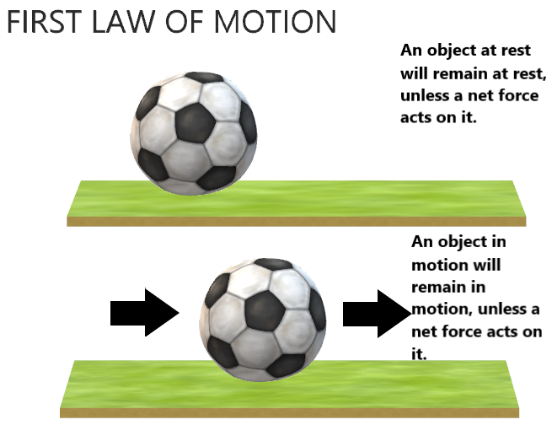
Egg Drop Evaluation
What does Newton’s First Law state (sometimes called the inertia law)?
Learning Target:
Who is going to have successful egg drops, and why?

Slide 123
Egg Drop Evaluation
Inertia:
Tendency of an object in motion wanting to stay in that same motion (both speed & direction) and an object at rest wants to stay at rest.
Potential Energy:
Energy at rest
Kinetic Energy:
Energy in motion

Slide 124
Egg Drop Evaluation
Inertia:
Tendency of an object in motion wanting to stay in that same motion (both speed & direction) and an object at rest wants to stay at rest.
Potential Energy:
Energy at rest
Kinetic Energy:
Energy in motion
Your Task:
Answer the following in complete paragraphs, using proper writing procedures (probably at least 2 paragraphs).
What is inertia, and how does it apply to the egg drop?
Where in the egg drop did we see potential energy?
Where in the egg drop did we see kinetic energy?
Choose one example of an egg drop, and explain scientifically why it was successful or not.

Slide 125
Today’s “Plan”—Thursday October 5, 2023 6th & 7th grade STEAM
Attendance/Brain Stretcher
Finish 6th grade presentations (Wyatt, Liam, Santiago)
Final Evaluations—make sure these are submitted to Schoology
Make bulleted list of what were some qualities of really good presentations?
Paragraph Writing Task
Begin Egg Drop Planning—we will do these next Tuesday
If time, check some things on estesparksteam.com (6th grade)
7th grade=drones if weather is favorable
Learning Target:
What makes for a good presentation?

Slide 126
Presentation Evaluations
In writing a quality paragraph, we want:
An introductory sentence.
Detail sentences expressing our key points.
A conclusion sentence that summarizes/wraps up the paragraph.
When we say “use proper writing form”, that includes:
Indent the paragraph
Capitalization
Proper paragraph structure
Punctuation
Learning Target:
What makes for a good presentation?

Slide 127
Presentation Evaluations
We had many very good backpack presentations in this class. One thing that we saw with some of these top presentations was _______________________________________________.
Another trait of quality presentations was ____________________________________________
_________________________________________________________________. One last thing that stood out with some of the best presentations was _________________________________
______________________________________________________________________________.
In observing these qualities, we saw some very good presentations to learn from.

Slide 128
Egg Drop Planning
Device holding egg cannot be bigger than 1’ x 1’ x 1’
Can use any materials except:
Helium or hydrogen filled balloons
Any motors or propulsion devices
Any heat source
Can have parachutes.
Must be able to put egg in/take out.
Frey will give you the egg.
You are providing the materials, so think about things you have around your house.
Everybody is on their own—no partners.
Egg Drop Planning:
Don’t look ideas up on the Internet!
Create a list of materials
Have a sketch of what your device will look like.
Write a paragraph about which materials you are using, how you are using them, and why this will be successful.
Submit to Egg Drop Planning on Schoology.

Slide 129
Egg Drop Evaluation
What does Newton’s First Law state (sometimes called the inertia law)?
Learning Target:
Who is going to have successful egg drops, and why?

Slide 130
Egg Drop Evaluation
Inertia:
Tendency of an object in motion wanting to stay in that same motion (both speed & direction) and an object at rest wants to stay at rest.
Potential Energy:
Energy at rest
Kinetic Energy:
Energy in motion

Slide 131
Today’s “Plan”—Tuesday October 10, 2023 6th & 7th grade STEAM
Attendance/Brain Stretcher
Egg Drop Planning—we will do these tomorrow!
Reminders
Check for missing assignments
Games section of estesparksteam.com
Learning Target:
What are some good educational games that could be added to our website?

Slide 132
Egg Drop Planning
Device holding egg cannot be bigger than 1’ x 1’ x 1’
Can use any materials except:
Helium or hydrogen filled balloons
Any motors or propulsion devices
Any heat source
Can have parachutes.
Must be able to put egg in/take out.
Frey will give you the egg.
You are providing the materials, so think about things you have around your house.
Everybody is on their own—no partners.
Egg Drop Planning:
Don’t look ideas up on the Internet!
Create a list of materials
Have a sketch of what your device will look like.
Write a paragraph about which materials you are using, how you are using them, and why this will be successful.
Submit to Egg Drop Planning on Schoology.

Slide 133
Go to “Games” tab on estesparksteam.com
Our internet filter now blocks some things that used to be allowed.
We need to find good educational games, focusing on:
Science, Math, Engineering, Coding, Art, Critical Thinking
Anything else?
Explore some good educational games
In a document, provide the following:
Name of game
What educational value does it have?
Copy the website address
When finished, submit to “Games” in Schoology
Learning Target:
What are some good educational games that could be added to our website?

Slide 134
Today’s “Plan”—Tuesday October 10, 2023 8th grade STEAM
Attendance/Brain Stretcher
October 27th Egg Drop Parameters
1st Demonstration for October 27th
Materials from you?
Materials from me?
Drones—flying through viewing the screen (if weather is favorable)
Games section of estesparksteam.com
Learning Target:
I can fly a drone to a target by watching the screen instead of the drone.

Slide 135
Today’s “Plan”—Wednesday October 11, 2023 6th & 7th grade STEAM
Attendance/Brain Stretcher Demonstration
Egg Drop Preparations
Go do Egg Drops!
If time, Egg Drop Evaluations
Learning Target:
I can identify scientific qualities that went into successful egg drops.

Slide 136
Egg Drop Evaluation
What does Newton’s First Law state (sometimes called the inertia law)?
Learning Target:
Who is going to have successful egg drops, and why?

Slide 137
Egg Drop Evaluation
Inertia:
Tendency of an object in motion wanting to stay in that same motion (both speed & direction) and an object at rest wants to stay at rest.
Potential Energy:
Energy at rest
Kinetic Energy:
Energy in motion

Slide 138
Egg Drop Evaluation
Inertia:
Tendency of an object in motion wanting to stay in that same motion (both speed & direction) and an object at rest wants to stay at rest.
Potential Energy:
Energy at rest
Kinetic Energy:
Energy in motion
Your Task:
Answer the following in complete paragraphs, using proper writing procedures (probably at least 2 paragraphs).
What is inertia, and how does it apply to the egg drop?
Where in the egg drop did we see potential energy?
Where in the egg drop did we see kinetic energy?
Choose one example of an egg drop, and explain scientifically why it was successful or not.

Slide 139
Today’s “Plan”—Wednesday October 11, 2023 8th grade STEAM
Learning Target:
I can identify scientific qualities that went into successful egg drops.
Attendance/Brain Stretcher Demonstration
Newton’s 1st Law of Motion
Hovercraft Planning

Slide 140
Hovercrafts….
A little about the science

Slide 141
What is Newton’s first law of motion?
An object will either remain at rest or in motion unless unbalanced forces act on it.

Slide 142
Inertia in sports
https://www.youtube.com/watch?v=08BFCZJDn9w

Slide 143
Why do we wear seatbelts?
https://www.youtube.com/watch?v=8b-Mogqy1h4

Slide 144
How can a hockey puck travel so far?

Slide 145
What are “forces”?
Friction???
Push/pull

Slide 146
What are unbalanced forces? How does a hovercraft work?
https://www.youtube.com/watch?v=0yFMF1sSb2E
https://www.youtube.com/watch?v=gCT7z0SlRT8

Slide 147
Your job
Create a hovercraft that can go 1 meter.
I will push (provide a force) to get the hovercraft going
The greatest distance hovered= winner
Materials- on the cart. You may acquire other things. This is pretty open on design

Slide 148
Today’s “Plan”—Thursday October 12, 2023 6th & 7th grade STEAM
Attendance/Brain Stretcher
Go through Code Red procedures for this classroom (a little different than others)
1st quarter ends Friday—we will stop grades now for 1st quarter.
Final backpack presentations (Liam, Wyatt, Santi
Review Egg Drops from yesterday
The science behind the Egg Drop
Egg Drop Evaluation
Learning Target:
I can identify scientific qualities that went into successful egg drops.

Slide 149
Egg Drop Evaluation
What does Newton’s First Law state (sometimes called the inertia law)?
Learning Target:
I can identify scientific qualities that went into successful egg drops.

Slide 150
Egg Drop Evaluation
Inertia:
Tendency of an object in motion wanting to stay in that same motion (both speed & direction) and an object at rest wants to stay at rest.
Potential Energy:
Energy at rest
Kinetic Energy:
Energy in motion

Slide 151
Egg Drop Evaluation
Inertia:
Tendency of an object in motion wanting to stay in that same motion (both speed & direction) and an object at rest wants to stay at rest.
Potential Energy:
Energy at rest
Kinetic Energy:
Energy in motion
Your Task:
Answer the following in complete paragraphs, using proper writing procedures (probably at least 2 paragraphs).
What is inertia, and how does it apply to the egg drop?
Where in the egg drop did we see potential energy?
Where in the egg drop did we see kinetic energy?
Choose one example of an egg drop, and explain scientifically why it was successful or not.

Slide 152
Today’s “Plan”—Thursday October 12, 2023 8th grade STEAM
Learning Target:
I can identify key characteristics to benefit the success of my hovercraft.
Attendance/Brain Stretcher
Go through Code Red procedures for this classroom (a little different than others)
Review Newton’s 1st Law of Motion
Hovercraft Planning
Materials list
Sketch
Written explanation
Hovercraft Building

Slide 153
Your job
Create a hovercraft that can go 1 meter.
I will push (provide a force) to get the hovercraft going
The greatest distance hovered= winner
Materials- on the cart. You may acquire other things. This is pretty open on design

Slide 154
Today’s “Plan”—Freyday October 13, 2023 6th & 7th grade STEAM
Attendance/Brain Stretcher
Review the science behind the Egg Drop
Inertia in sports
Why we wear seat belts
Finish Egg Drop Evaluation
“Special Task”
Learning Target:
I can identify scientific qualities that went into successful egg drops.

Slide 155
Inertia in sports
https://www.youtube.com/watch?v=08BFCZJDn9w

Slide 156
Why do we wear seatbelts?
https://www.youtube.com/watch?v=8b-Mogqy1h4

Slide 157
Egg Drop Evaluation
Inertia:
Tendency of an object in motion wanting to stay in that same motion (both speed & direction) and an object at rest wants to stay at rest.
Potential Energy:
Energy at rest
Kinetic Energy:
Energy in motion
Your Task:
Answer the following in complete paragraphs, using proper writing procedures (probably at least 2 paragraphs).
What is inertia, and how does it apply to the egg drop?
Where in the egg drop did we see potential energy?
Where in the egg drop did we see kinetic energy?
Choose one example of an egg drop, and explain scientifically why it was successful or not.

Slide 158
Go to “Games” tab on estesparksteam.com
Our internet filter now blocks some things that used to be allowed.
We need to find good educational games, focusing on:
Science, Math, Engineering, Coding, Art, Critical Thinking
Anything else?
Explore some good educational games
In a document, provide the following:
Name of game
What educational value does it have?
Copy the website address
When finished, submit to “Games” in Schoology
Learning Target:
What are some good educational games that could be added to our website?

Slide 159
Today’s “Plan”—Thursday October 12, 2023 8th grade STEAM
Learning Target:
I can identify key characteristics to benefit the success of my hovercraft.
Attendance/Brain Stretcher
Finish Hovercraft Building

Slide 160
Your job
Create a hovercraft that can go 1 meter.
I will push (provide a force) to get the hovercraft going
The greatest distance hovered= winner
Materials- on the cart. You may acquire other things. This is pretty open on design

Slide 161
Today’s “Plan”—Monday October 16, 2023 6th & 7th grade STEAM
Attendance/Brain Stretcher.
Check quarter grades.
Explain STEM Night
Bonus for attending
Will do 2nd Egg Drop
Egg Drop #2 Planning
List of materials.
Sketch.
Brief paragraph of what will improve/change over your previous egg drop.
Learning Target:
I can identify scientific qualities that went into successful egg drops.

Slide 162
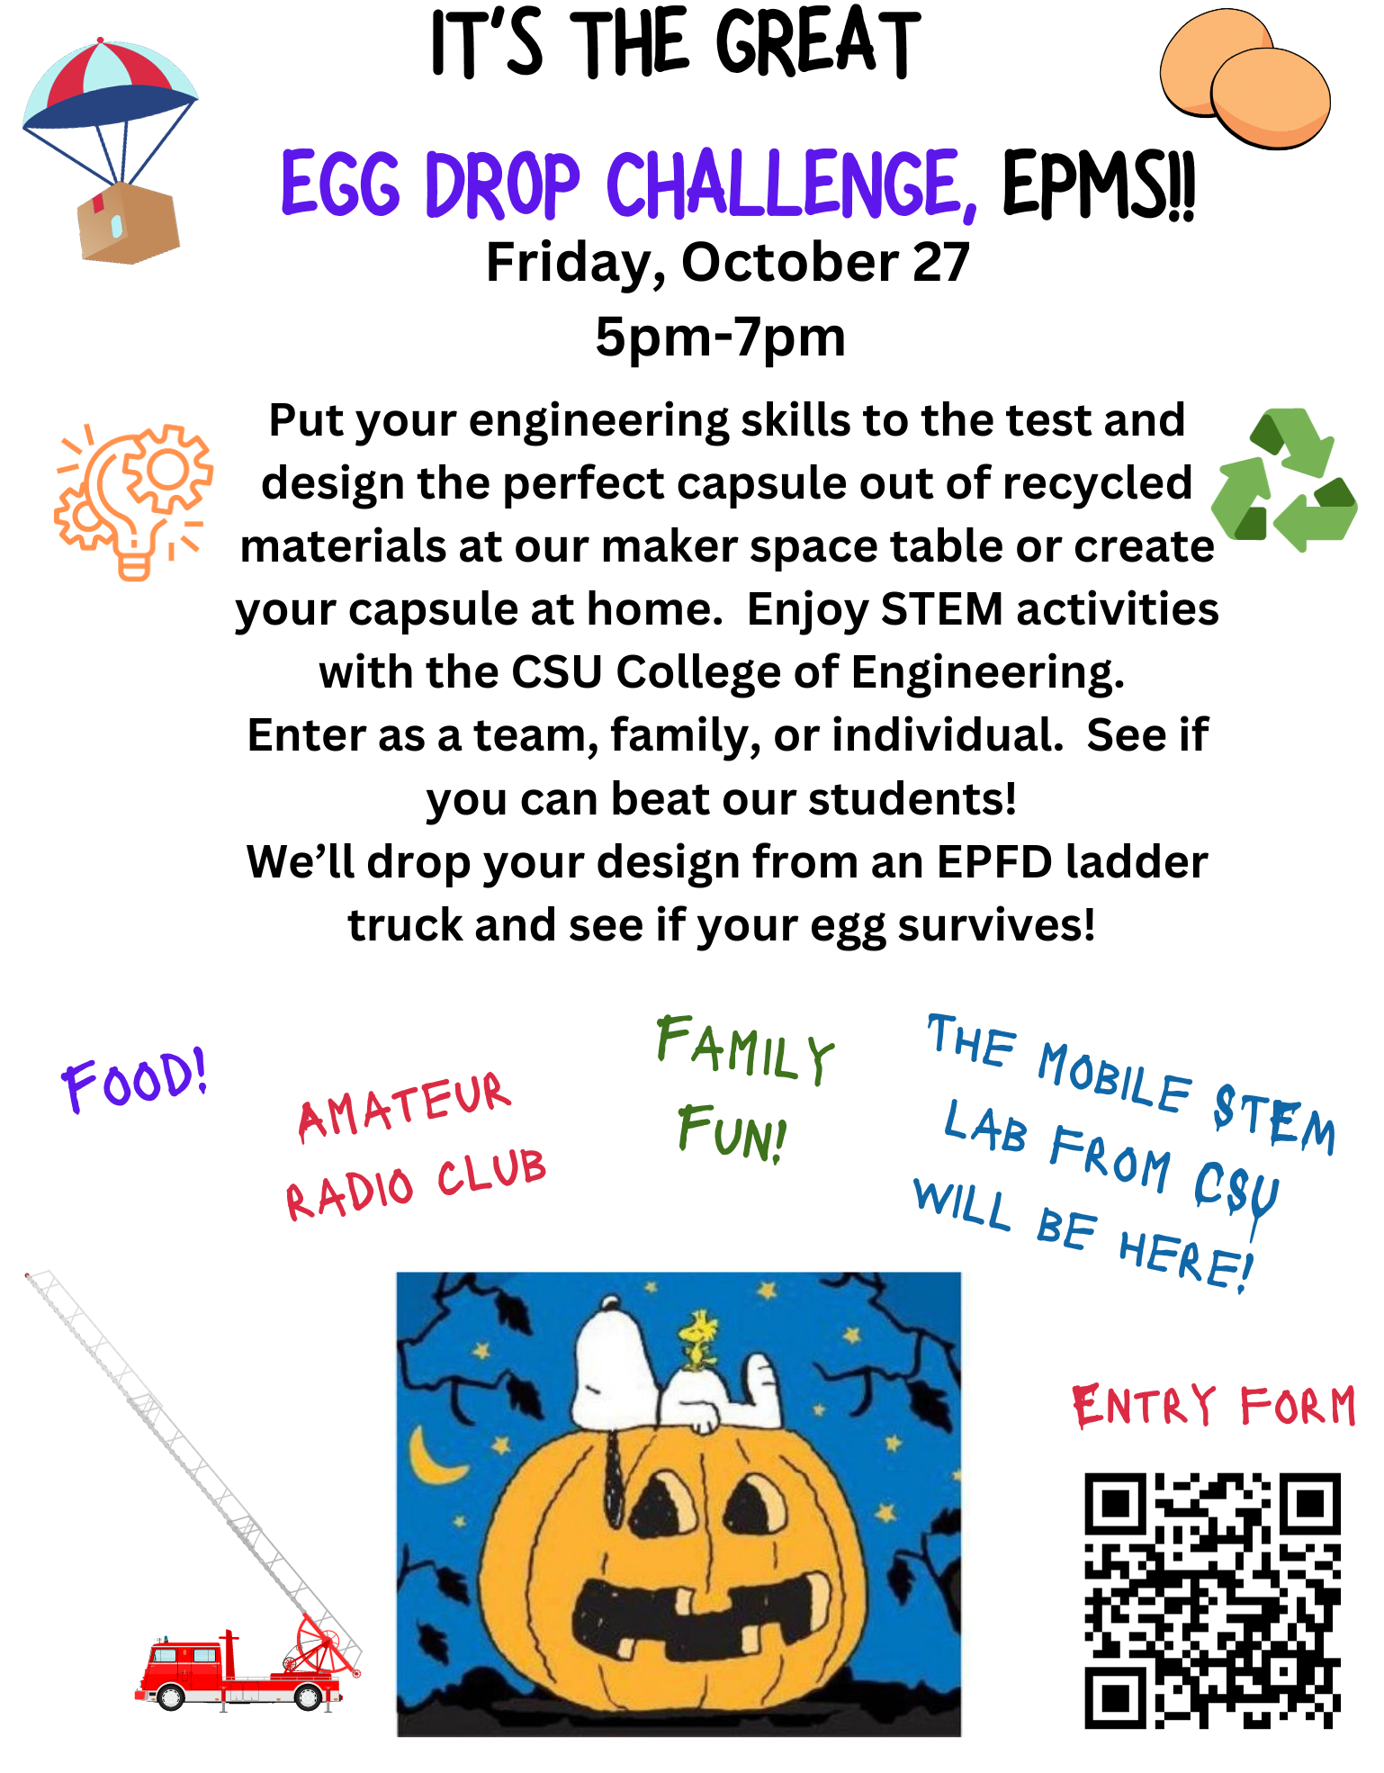

Slide 163
STEM Night: Friday October 27th
It is from 5:00pm-7:00pm, so attendance is not required.
Will give bonus for those in attendance.
Egg drop #2 will be dropped from fire truck ladder (about 30’?).
If you cannot attend, we will have somebody drop it for you.
Parameters for this Egg Drop:
-capsule may not be any larger than 8” x 8”
-made of recycled materials
-glass, motors, chemicals, or heat sources are NOT allowed
-raw egg (not supplied) must be enclosed within capsule (you can get an egg from me)
-must withstand a drop from 30 feet

Slide 164
Today’s “Plan”—Monday October 16, 2023 8th grade STEAM
Attendance/Brain Stretcher.
Check quarter grades.
Explain STEM Night
Bonus for attending
Will do 2nd Egg Drop
Finish hovercraft design—will test tomorrow
Egg Drop #2 Planning
List of materials.
Sketch.
Brief paragraph of what will improve/change over your previous egg drop.
Learning Target:
I can identify scientific qualities that went into successful egg drops.

Slide 165
STEM Night: Friday October 27th
It is from 5:00pm-7:00pm, so attendance is not required.
Will give bonus for those in attendance.
Egg drop #2 will be dropped from fire truck ladder (about 30’?).
If you cannot attend, we will have somebody drop it for you.
Parameters for this Egg Drop:
-capsule may not be any larger than 8” x 8”
-made of recycled materials
-glass, motors, chemicals, or heat sources are NOT allowed
-raw egg (not supplied) must be enclosed within capsule (you can get an egg from me)
-must withstand a drop from 30 feet

Slide 166
Today’s “Plan”—Tuesday October 17, 2023 6th & 7th grade STEAM
Attendance/Brain Stretcher (modified schedule today)
STEM Night Reminders
Bonus for attending
Can do as family, partners, individual
Explain Hovercrafts
Hovercraft Planning
Materials list
Sketch
Written explanation
Learning Target:
I can identify scientific qualities that went into successful egg drops.

Slide 168
STEM Night: Friday October 27th
It is from 5:00pm-7:00pm, so attendance is not required.
Will give bonus for those in attendance.
Egg drop #2 will be dropped from fire truck ladder (about 30’?).
If you cannot attend, we will have somebody drop it for you.
Parameters for this Egg Drop:
-capsule may not be any larger than 8” x 8”
-made of recycled materials
-glass, motors, chemicals, or heat sources are NOT allowed
-raw egg (not supplied) must be enclosed within capsule (you can get an egg from me)
-must withstand a drop from 30 feet

Slide 169
Hovercrafts….
A little about the science

Slide 170
How can a hockey puck travel so far?

Slide 171
What are “forces”?
Friction???
Push/pull

Slide 172
What are unbalanced forces? How does a hovercraft work?
https://www.youtube.com/watch?v=0yFMF1sSb2E
https://www.youtube.com/watch?v=gCT7z0SlRT8

Slide 173
Your job
Create a hovercraft that can go 1 meter.
I will push (provide a force) to get the hovercraft going
The greatest distance hovered= winner
Materials- on the cart. You may acquire other things. This is pretty open on design

Slide 174
Hovercraft Planning:
List of Materials
Sketch (be sure to label the materials)
Paragraph explaining how you are going to build this, and your reasoning for the materials you are using.

Slide 175
Today’s “Plan”—Tuesday October 17, 2023 8th grade STEAM
Learning Target:
I can identify key characteristics to benefit the success of my hovercraft.
Attendance/Brain Stretcher
Present your reasoning to Mark Speckien
Test Hovercrafts

Slide 176
Today’s “Plan”—Wednesday October 18, 2023 6th & 7th grade STEAM
Attendance/Brain Stretcher
STEM Night Reminders
Bonus for attending
Can do as family, partners, individual
Entry Form
Continue Hovercraft Planning
Materials list
Sketch
Written explanation in paragraph form
Begin building hovercrafts
Learning Target:
I can utilize materials to plan a successful hovercraft.

Slide 178
Hovercraft Planning:
List of Materials
Sketch (be sure to label the materials)
Paragraph explaining how you are going to build this, and your reasoning for the materials you are using.

Slide 179
Today’s “Plan”—Wednesday October 18, 2023 8th grade STEAM
Learning Target:
I can identify key characteristics to benefit the success of my hovercraft.
Attendance/Brain Stretcher
STEM Night Reminders
Bonus for attending
Can do as family, partners, individual
Entry Form
Review hovercrafts from yesterday
Getting ready for Friday October 27th

Slide 180
Hovercraft Evaluation
Learning Target:
I can identify key characteristics to benefit the success of my hovercraft.
In paragraph form (using proper writing procedures), answer the following:
How did your hovercraft perform?
What was something that you did well with your hovercraft?
What was something you could have improved with your hovercraft?
Be sure to have a topic/introductory sentence and a conclusion sentence!

Slide 181
Today’s “Plan”—Thursday October 19, 2023 6th & 7th grade STEAM
Attendance/Blooket Brain Stretcher
STEM Night Reminders--Egg Drops are due Wed.
Bonus for attending
Can do as family, partners, individual
Missing Work
Blooket
Continue Hovercraft Planning
Materials list
Sketch
Written explanation in paragraph form
Begin/Continue building hovercrafts
Learning Target:
I can utilize materials to plan a successful hovercraft.

Slide 182
Today’s “Plan”—Thursday October 19, 2023 8th grade STEAM
Learning Target:
I can identify key characteristics to benefit the success of my hovercraft.
Attendance/Brain Stretcher
STEM Night Reminders—Egg Drops are due Wed.
Bonus for attending
Can do as family, partners, individual
Entry Form
Blooket
Getting ready for Friday October 27th

Slide 183
Today’s “Plan”—Tuesday October 24, 2023 6th & 7th grade STEAM
Attendance/Was anyone gone yesterday?
STEM Night Reminders—let’s have egg drops done by the end of class Wednesday.
Bonus for attending
Can do as family, partners, individual
Finish video from yesterday—put in grade
Do Video Quiz on Schoology—use your video organizer to help you.
Work on Egg Drop or Hovercraft.
Learning Target:
I can utilize materials to plan a successful hovercraft.

Slide 184
Video Organizer
4. 250
5. 100
alarm system
22.sugar
treat
polygraph
hypnosis
emotion
meditation
how the body works
nerves

Slide 185
Today’s “Plan”—Tuesday October 24, 2023 8th grade STEAM
Attendance/Was anyone gone yesterday?
STEM Night Reminders—let’s have egg drops done by the end of class Wednesday.
Bonus for attending
Can do as family, partners, individual
Finish video from yesterday—put in grade
Do Video Quiz on Schoology—use your video organizer to help you.
Work on Egg Drop or Project.
Learning Target:
I can identify key characteristics to benefit the success of my hovercraft.

Slide 186
Today’s “Plan”—Wednesday October 25, 2023 6th & 7th grade STEAM
Attendance/Was anyone gone yesterday?
STEM Night Reminders—let’s try to have egg drops done by the end of class today. If have at home, bring them in!
Put groups in for Egg Drop into Excel document
Work on Egg Drop or Hovercraft.
If you are done with both, don’t bug anyone else!
Learning Target:
I can utilize materials to plan a successful hovercraft.

Slide 187
Today’s “Plan”—Wednesday October 25, 2023 8th grade STEAM
Attendance/Was anyone gone yesterday?
STEM Night Reminders—let’s try to have egg drops done by the end of class today. If have at home, bring them in!
Put groups in for Egg Drop into Excel document
Work on Egg Drop or Demonstration Project.
If you don’t have materials here for demonstration project, you need to get those in.
Put in orders?
Learning Target:
I can identify key characteristics to benefit the success of my hovercraft.

Slide 189
Video Organizer
4. 250
5. 100
alarm system
22.sugar
treat
polygraph
hypnosis
emotion
meditation
how the body works
nerves

Slide 190
Today’s “Plan”—Thursday October 26, 2023 6th & 7th grade STEAM
Attendance
STEM Night Reminders—go through tomorrow’s schedule
Who is done with their hovercraft?
Work on Egg Drop or Hovercraft.
Find educational games.
Create document, put name of game and the website link.
Learning Target:
I can utilize materials to plan a successful hovercraft.

Slide 192
Today’s “Plan”—Thursday October 26, 2023 8th grade STEAM
Attendance
STEM Night Reminders—go through tomorrow’s schedule
Who is done with their Egg Drop?
Work on Egg Drop or Demonstration Project.
Find educational games.
Create document, put name of game and the website link.
Learning Target:
I can identify key characteristics to benefit the success of my hovercraft.

Slide 193
Video Organizer
4. 250
5. 100
alarm system
22.sugar
treat
polygraph
hypnosis
emotion
meditation
how the body works
nerves

Slide 194
Today’s “Plan”—Freyday October 27, 2023 6th & 7th grade STEAM
Attendance
STEM Night Reminders—go through tomorrow’s schedule
How you will get bonus for being here tonight.
Need to have picture of you in front of the fire truck
Who is done with their hovercraft & egg drop?
Work on Egg Drop or Hovercraft.
If done, find educational games.
Create document, put name of game and the website link.
If people finish building, will test hovercrafts, grade egg drops
Learning Target:
I can utilize materials to plan a successful hovercraft.

Slide 196
Today’s “Plan”—Freyday October 27, 2023 8th grade STEAM
Attendance
STEM Night Reminders—go through tomorrow’s schedule
How you will get bonus for being here tonight.
Need to have picture of you in front of the fire truck
Who is done with their egg drop?
Work on Egg Drop or or Demonstration Project
If done, find educational games.
Create document, put name of game and the website link.
Will grade egg drops towards the end
Learning Target:
I can identify key characteristics to benefit the success of my hovercraft.

Slide 197
Today’s “Plan”—Monday October 30, 2023 6th & 7th grade STEAM
Attendance
Review STEM Night, bonus for who was there
Begin testing hovercrafts
Hovercraft Evaluation
If done, find educational games.
Create document, put name of game and the website link.
Learning Target:
I can evaluate what worked well and what could have been improved with my hovercraft design.

Slide 198
Hovercraft Evaluation
Learning Target:
I can evaluate what worked well and what could have been improved with my hovercraft design.
Write a well constructed paragraph(s) which addresses the following:
Has a topic/introductory sentence.
Details some things that went well with your hovercraft.
Explain what you could have done better.
How did this engineering project compare to some of our others (boat, egg drop)?
Has a conclusion sentence.
When finished, submit to Hovercraft Evaluation

Slide 199
Today’s “Plan”—Monday October 30, 2023 8th grade STEAM
Attendance
Review STEM Night, bonus for who was there
Demonstration Projects
If not have anything for demonstration projects, find educational games.
Create document, put name of game and the website link.
Submit what you have so far to Games in Schoology.
Learning Target:
I can plan out an effective demonstration project.

Slide 200
Today’s “Plan”—Tuesday October 31, 2023 6th grade STEAM
Attendance/Brain Stretcher
Final Hovercraft Test
Hovercraft Evaluation
If done, continue finding educational games.
Create document, put name of game and the website link.
Begin “Million Dollar Idea”
Learning Target:
I can evaluate what worked well and what could have been improved with my hovercraft design.

Slide 201
Hovercraft Evaluation
Learning Target:
I can evaluate and communicate what worked well and what could have been improved with my hovercraft design.
Write a well constructed paragraph(s) which addresses the following:
Has a topic/introductory sentence.
Details some things that went well with your hovercraft.
Explain what you could have done better.
How did this engineering project compare to some of our others (boat, egg drop)?
Has a conclusion sentence.
When finished, submit to Hovercraft Evaluation

Slide 202
Today’s “Plan”—Tuesday October 31, 2023 7th grade STEAM
Attendance/Brain Stretcher
Evelyn & Danaly test their Hovercraft
Review Hovercraft Evaluation
Final Hovercraft Test
Give students time to finish Hovercraft Evaluation
If done, continue finding educational games for our website.
Create document, put name of game and the website link.
Begin “Million Dollar Idea”
Learning Target:
I can evaluate and communicate what worked well and what could have been improved with my hovercraft design.

Slide 203
Hovercraft Evaluation
Learning Target:
I can evaluate and communicate what worked well and what could have been improved with my hovercraft design.
Write a well constructed paragraph(s) which addresses the following:
Has a topic/introductory sentence.
Details some things that went well with your hovercraft.
Explain what you could have done better.
How did this engineering project compare to some of our others (boat, egg drop)?
Has a conclusion sentence.
When finished, submit to Hovercraft Evaluation

Slide 204
Million Dollar Idea
10 Genius Kid Inventions that Made Millions
https://www.youtube.com/watch?v=FJQ-ddCGPAE

Slide 205
Hovercraft Evaluation
Learning Target:
I can evaluate what worked well and what could have been improved with my hovercraft design.
Write a well constructed paragraph(s) which addresses the following:
Has a topic/introductory sentence.
Details some things that went well with your hovercraft.
Explain what you could have done better.
How did this engineering project compare to some of our others (boat, egg drop)?
Has a conclusion sentence.
When finished, submit to Hovercraft Evaluation

Slide 206
Today’s “Plan”—Tuesday October 31, 2023 8th grade STEAM
Attendance/Brain Stretcher
Demonstration Projects
Show video examples
Work on Demonstration Projects!
Learning Target:
I can plan out an effective demonstration project.

Slide 207
Today’s “Plan”—Wednesday November 1, 2023 6th & 7th grade STEAM
Attendance
Review Hovercraft Evaluation
Begin “Million Dollar Idea”
Video: 10 Genius Kid Inventions (6th grade)
Video: Shark Tank: Kid-Preneurs Edition(7th grade)
Why do “kids” make great inventors?
Brainstorm Million Dollar Ideas—What bugs you? How are you going to fix it? What is going to be your Million Dollar Idea?
If time at end, Blooket
Learning Target:
I can identify a common problem and brainstorm solutions to that problem.

Slide 208
Million Dollar Idea Project
Once you have idea(s), submit to Brainstorm Million Dollar Ideas
For this project, in the end you will need:
A description
A catchy name
A logo
A pitch that you will present to the class
Learning Target:
I can identify a common problem and brainstorm solutions to that problem.

Slide 209
Million Dollar Idea
10 Genius Kid Inventions that Made Millions
https://www.youtube.com/watch?v=FJQ-ddCGPAE

Slide 210
Today’s “Plan”—Wednesday November 1, 2023 8th grade STEAM
Attendance/Brain Stretcher
Demonstration Projects
Show video examples
Continue working on Demonstration Projects!
We want videos of your demo projects
Need somebody to design button for Mrs. Greenway
Blooket at the end
Learning Target:
I can plan out an effective demonstration project.

Slide 211
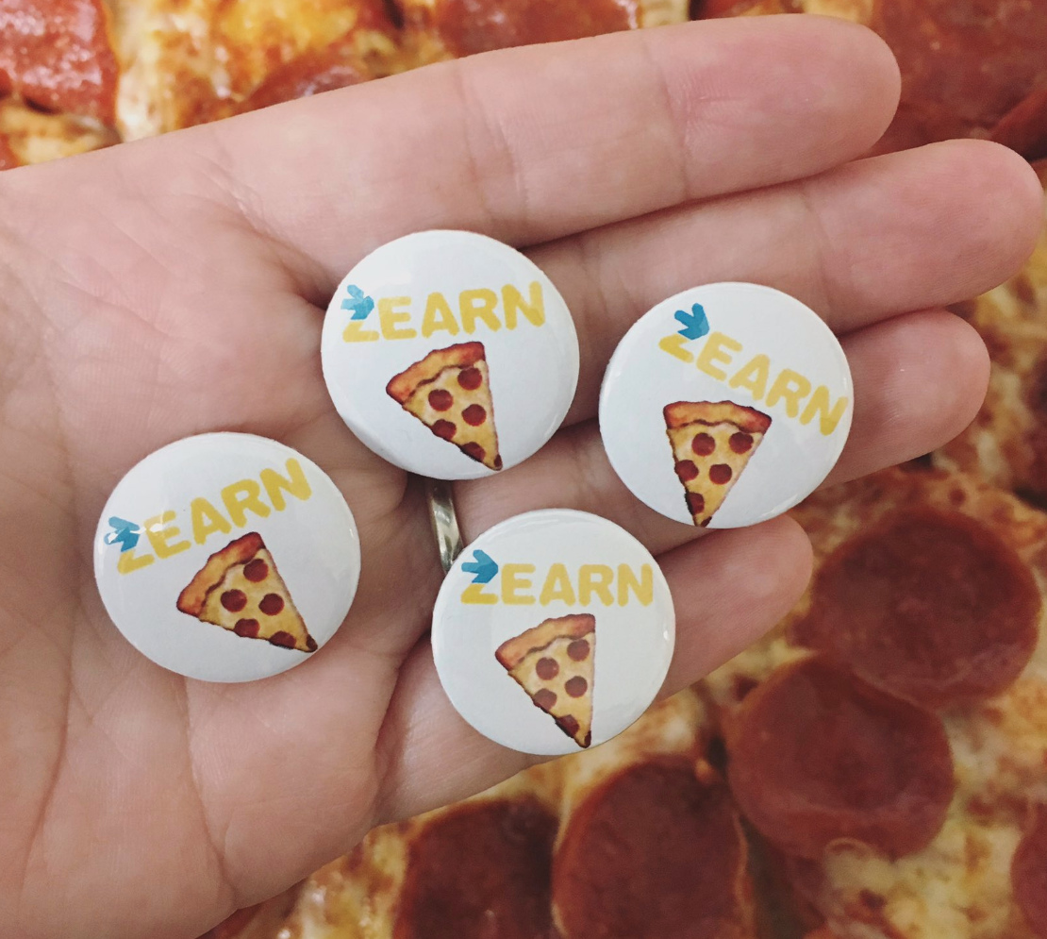

Slide 212
Today’s “Plan”—Thursday November 2, 2023 6th & 7th grade STEAM
Attendance/Brain Stretcher
Video: ”Silly Inventions That Made Their Inventors Rich”
Continue “Million Dollar Idea”
Brainstorm Million Dollar Ideas—What bugs you? How are you going to fix it? What is going to be your Million Dollar Idea?
Will then need:
Invention Description (write a brief paragraph about your idea/product)
Invention Name (try to think of a catchy name for your idea/product)
Invention Logo
Begin preparing your Pitch that you will give to the class
Learning Target:
I can identify a common problem and brainstorm solutions to that problem.

Slide 213
Today’s “Plan”—Freyday November 3, 2023 6th & 7th grade STEAM
Attendance/Brain Stretcher
Continue “Million Dollar Idea”
Brainstorm Million Dollar Ideas—What bugs you? How are you going to fix it? What is going to be your Million Dollar Idea?
Will then need:
Invention Description (write a brief paragraph about your idea/product)
Invention Name (try to think of a catchy name for your idea/product)
Invention Logo
Begin preparing your Pitch that you will give to the class
If time, Blooket at the end.
Learning Target:
I can identify a common problem and brainstorm solutions to that problem.

Slide 214
Million Dollar Idea Project
Once you have idea(s), submit to Brainstorm Million Dollar Ideas
For this project, in the end you will need:
Invention Description
A catchy Invention Name
Invention Logo
An Invention Pitch that you will present to the class
Learning Target:
I can identify a common problem and brainstorm solutions to that problem.

Slide 215
Million Dollar Idea
10 Genius Kid Inventions that Made Millions
https://www.youtube.com/watch?v=FJQ-ddCGPAE

Slide 216
Today’s “Plan”—Freyday November 3, 2023 8th grade STEAM
Attendance/Brain Stretcher
We need to clean up our messes!
Keep your materials organized
Continue working on Demonstration Projects!
We want videos of your demo projects
Need somebody to design button for Mrs. Greenway
Will do a Blooket towards the end of class.
Learning Target:
I can plan out an effective demonstration project.

Slide 218
Today’s “Plan”—Monday November 6, 2023 6th & 7th grade STEAM
Attendance
Review “Million Dollar Idea”
Brainstorm Million Dollar Idea
You will then need:
Invention Description (write a brief paragraph about your idea/product)
Invention Name (try to think of a catchy name for your idea/product)
Invention Logo
Invention Pitch that you will present to the class
Learning Target:
I can create a successful pitch for my “Million Dollar Idea” project.

Slide 219
Million Dollar Idea
10 Genius Kid Inventions that Made Millions
https://www.youtube.com/watch?v=FJQ-ddCGPAE

Slide 220
Today’s “Plan”—Monday November 6, 2023 8th grade STEAM
Attendance/Brain Stretcher
Who has a video made of their Demonstration Project?
We want videos of your demo projects
Submit to Video 1st Demo Project
Work on Final Explanation #1
Get our logo from estesparksteam.com
Show template
Continue working on Demonstration Projects.
Work on laptops for anyone with “nothing to do”.
Learning Target:
I can plan out an effective demonstration project.

Slide 221
Electricity ”Magic”
The Science Behind This:
Electricity is all around us. It is even in you! Do you know what the difference is between a conductor and an insulator of electricity? A conductor means electricity passes through something; an insulator does not allow electricity to pass through it.
What You Do:
With a friend, one of you hold onto one end of the “magic stick”, and then have your friend hold the other end. Then with your empty hands, touch each other’s hand or fingers. What happens?

Slide 222
Today’s “Plan”—Tuesday November 7, 2023 6th & 7th grade STEAM
Attendance
Who is ready to present “Million Dollar Ideas”?
With remaining time, finish up Million Dollar Ideas
Learning Target:
I can create a successful pitch for my “Million Dollar Idea” project.

Slide 223
Million Dollar Idea
You need submitted to Schoology:
Brainstorm Million Dollar Idea
Invention Description (write a brief paragraph about your idea/product)
Invention Name (try to think of a catchy name for your idea/product)
Invention Logo
Invention Pitch that you will present to the class

Slide 224
Today’s “Plan”—Tuesday November 7, 2023 8th grade STEAM
Attendance/Brain Stretcher
Look at more videos
Submit to Video 1st Demo Project
Look at Final Explanation #1
Get our logo from estesparksteam.com
Show template
Continue working on Demonstration Projects and Final Explanation #1
Work on laptops for anyone with “nothing to do”.
Learning Target:
I can plan out an effective demonstration project.

Slide 225
Today’s “Plan”—Wednesday November 8, 2023 6th grade STEAM
Attendance/Brain Stretcher
Finish presenting “Million Dollar Ideas”
With remaining time, finish up Million Dollar Ideas
Learning Target:
I can create a successful pitch for my “Million Dollar Idea” project.

Slide 226
Million Dollar Idea
You need submitted to Schoology:
Brainstorm Million Dollar Idea
Invention Description (write a brief paragraph about your idea/product)
Invention Name (try to think of a catchy name for your idea/product)
Invention Logo
Invention Pitch that you will present to the class

Slide 227
Today’s “Plan”—Wednesday November 8, 2023 8th grade STEAM
Attendance/Brain Stretcher
Look at more videos
Submit to Video 1st Demo Project
Look at Final Explanation #1
Get our logo from estesparksteam.com
Show example
Continue working on Demonstration Projects and Final Explanation #1
Work on laptops for anyone with “nothing to do”.
Learning Target:
I can plan out an effective demonstration project.

Slide 228
Electricity ”Magic”
The Science Behind This:
Electricity is all around us. It is even in you! Do you know what the difference is between a conductor and an insulator of electricity? A conductor means electricity passes through something; an insulator does not allow electricity to pass through it.
What You Do:
With a friend, one of you hold onto one end of the “magic stick”, and then have your friend hold the other end. Then with your empty hands, touch each other’s hand or fingers. What happens?

Slide 229
Today’s “Plan”—Thursday November 9, 2023 6th & 7th grade STEAM
Attendance/Crypto Hack Brain Stretcher
Present more “Million Dollar Ideas”?
With remaining time, finish up Million Dollar Ideas or look for good Educational Games
Learning Target:
I can create a successful pitch for my “Million Dollar Idea” project.

Slide 230
Today’s “Plan”—Freyday November 10, 2023 6th grade STEAM
Attendance/Brain Stretcher
Finish presenting “Million Dollar Ideas”
If time, keep looking up educational Games
Learning Target:
I can create a successful pitch for my “Million Dollar Idea” project.

Slide 231
Today’s “Plan”—Freyday November 10, 2023 7th grade STEAM
Attendance/Brain Stretcher
Finish presenting “Million Dollar Ideas”
Explain our Science Day for Elementary Students
Research ideas for Science Festival Project Proposal
Learning Target:
I can create a successful pitch for my “Million Dollar Idea” project.

Slide 232
Little Shop of Physics

Slide 246
Little Shop of Physics

Slide 247
Million Dollar Idea
You need submitted to Schoology:
Brainstorm Million Dollar Idea
Invention Description (write a brief paragraph about your idea/product)
Invention Name (try to think of a catchy name for your idea/product)
Invention Logo
Invention Pitch that you will present to the class

Slide 248
Today’s “Plan”—Freyday November 10, 2023 8th grade STEAM
Attendance/Brain Stretcher
Begin planning Demonstration Project #2
Finish filming Video Demo Project #1
Finish Final Explanation #1
Educational Games
Learning Target:
I can plan out an effective demonstration project.

Slide 249
Today’s “Plan”—Monday November 13, 2023 6th grade STEAM
Attendance/Brain Stretcher
Finish presenting “Million Dollar Ideas”
Begin Coding
Learning Target:
I can create a successful pitch for my “Million Dollar Idea” project.

Slide 250
Today’s “Plan”—Monday November 13, 2023 7th grade STEAM
Attendance/Brain Stretcher
Continue explaining our Science Day for Elementary Students
Research ideas for Science Festival Project Proposal
Submit to Schoology when have 3 ideas
Learning Target:
I can create an engaging project for a target audience of 3-5th graders.

Slide 251
Today’s “Plan”—Monday November 13, 2023 8th grade STEAM
Attendance/Brain Stretcher
Coding
Fill out Excel spreadsheet
Planning Demonstration Project #2
Finish filming Video Demo Project #1
Finish Final Explanation #1
Learning Target:
I can plan out an effective demonstration project.

Slide 252
Today’s “Plan”—Monday November 13, 2023 8th grade STEAM 2
Attendance/Brain Stretcher
Fill out Excel spreadsheet
Demonstration #2 Planning
Finish filming Video Demo Project #1
Finish Final Explanation #1
Video 2nd Demo Project
Learning Target:
I can plan out an effective demonstration project.

Slide 253
Today’s “Plan”—Tuesday November 14, 2023 6th grade STEAM
Attendance/Brain Stretcher
Finish presenting “Million Dollar Ideas” if all 4 people are here
Continue Coding
Do Dance Party
Will then pick at least 2 more “Hour of Code” Activities
When you complete an “Hour of Code” activity, show it to Frey so you can get credit.
Learning Target:
I can create a successful pitch for my “Million Dollar Idea” project.

Slide 254
Today’s “Plan”—Tuesday November 14, 2023 7th grade STEAM
Attendance/Brain Stretcher
Continue explaining our Science Day for Elementary Students
Research ideas for Science Festival Project Proposal
Submit to Schoology when have 3 ideas.
Begin bringing in materials to work on these projects—I will give you class time if you are using it.
Begin Coding.
Learning Target:
I can create an engaging project for a target audience of 3-5th graders.

Slide 255
Today’s “Plan”—Tuesday November 14, 2023 8th grade STEAM
Attendance/Brain Stretcher
Fill out Excel spreadsheet if you didn’t already
Finish filming Video Demo Project #1
Finish Final Explanation #1
Demonstration #2 Planning
Materials list, what do you need from me, brief description
2nd Video Demo Project
Final Explanation #2
Coding
Do Dance Party
Will then pick at least 2 more “Hour of Code” Activities
Show to Frey BEFORE you start.
When you complete an “Hour of Code” activity, show it to Frey so you can get credit.
Learning Target:
I can plan out an effective demonstration project.

Slide 256
Today’s “Plan”—Tuesday November 14, 2023 8th grade STEAM 2
Attendance/Brain Stretcher
Fill out Excel spreadsheet (if you didn’t already)
Finish filming Video Demo Project #1
Finish Final Explanation #1
Demonstration #2 Planning
Video 2nd Demo Project
Begin Coding
Learning Target:
I can plan out an effective demonstration project.

Slide 257
Today’s “Plan”—Wednesday November 15, 2023 7th grade STEAM
Attendance/Brain Stretcher
Continue explaining our Science Day for Elementary Students
Research ideas for Science Festival Project Proposal
Submit to Schoology when have 3 ideas.
Begin bringing in materials to work on these projects—I will give you class time if you are using it.
Begin Coding.
Learning Target:
I can create an engaging project for a target audience of 3-5th graders.

Slide 258
Today’s “Plan”—Wednesday November 15, 2023 8th grade STEAM
Attendance/Brain Stretcher
Fill out Excel spreadsheet if you didn’t already
Finish filming Video Demo Project #1
Finish Final Explanation #1
Demonstration #2 Planning
Materials list, what do you need from me, brief description
2nd Video Demo Project
Final Explanation #2
Coding
Do Dance Party
Will then pick at least 2 more “Hour of Code” Activities
Show to Frey BEFORE you start.
When you complete an “Hour of Code” activity, show it to Frey so you can get credit.
Learning Target:
I can plan out an effective demonstration project.

Slide 259
Today’s “Plan”—Wednesday November 15, 2023 8th grade STEAM 2
Attendance/Brain Stretcher
Fill out Excel spreadsheet (if you didn’t already)
Finish filming Video Demo Project #1
Finish Final Explanation #1
Demonstration #2 Planning
Video 2nd Demo Project
Begin Coding
Learning Target:
I can plan out an effective demonstration project.

Slide 260
Today’s “Plan”—Thursday November 16, 2023 6th grade STEAM
Attendance/Brain Stretcher
Finish presenting “Million Dollar Ideas” if all 4 people are here
Check Coding
Pull up one of the “Hour of Code” activities you have done
Create a Kahoot or a Blooket
Minimum 20 questions
Topics can include:
Science, Technology, Math, anything school related...
Current events
Random “stuff”—don’t have too many of those though
Work with your table partner: one type up the Kahoot/Blooket, use the other person’s iPad to look up info
Learning Target:
I can create a successful pitch for my “Million Dollar Idea” project.

Slide 261
Today’s “Plan”—Thursday November 16, 2023 7th grade STEAM
Attendance/Brain Stretcher
Continue explaining our Science Day for Elementary Students
Does anyone have materials to start working on Science Festival project?
Create a Kahoot or a Blooket
Minimum 20 questions
Topics can include:
Science, Technology, Math, anything school related...
Current events
Random “stuff”—don’t have too many of those though
Work with your table partner: one type up the Kahoot/Blooket, use the other person’s iPad to look up info
Learning Target:
I can create an engaging project for a target audience of 3-5th graders.

Slide 262
Today’s “Plan”—Thursday November 16, 2023 8th grade STEAM
Attendance/Brain Stretcher
Continue explaining our Science Day for Elementary Students
Does anyone have materials to film/work on Science Festival project?
Create a Kahoot or a Blooket
Minimum 20 questions
Topics can include:
Science, Technology, Math, anything school related...
Current events
Random “stuff”—don’t have too many of those though
Work with your table partner: one type up the Kahoot/Blooket, use the other person’s iPad to look up info
Learning Target:
I can plan out an effective demonstration project.

Slide 263
Today’s “Plan”—Thursday November 16, 2023 8th grade STEAM 2
Attendance/Brain Stretcher
Continue explaining our Science Day for Elementary Students
Does anyone have materials to film/work on Science Festival project?
Create a Kahoot or a Blooket
Minimum 20 questions
Topics can include:
Science, Technology, Math, anything school related...
Current events
Random “stuff”—don’t have too many of those though
Work with your table partner: one type up the Kahoot/Blooket, use the other person’s iPad to look up info
Learning Target:
I can plan out an effective demonstration project.

Slide 264
Today’s “Plan”—Freyday November 17, 2023 6th grade STEAM
Attendance/Brain Stretcher
Check Coding
Pull up one of the “Hour of Code” activities you have done
Play a couple of Kahoots/Blookets
Finish making Kahoots/Blookets
Minimum 20 questions
Topics can include:
Science, Technology, Math, anything school related...
Current events
Random “stuff”—don’t have too many of those though
Learning Target:
I can show I know basic block coding.

Slide 265
Today’s “Plan”—Freyday November 17, 2023 7th grade STEAM
Attendance/Brain Stretcher
Continue explaining our Science Day for Elementary Students
Does anyone have materials to start working on Science Festival project?
Play a couple of Kahoots/Blookets
Finish making Kahoots/Blookets
Minimum 20 questions
Topics can include:
Science, Technology, Math, anything school related...
Current events
Random “stuff”—don’t have too many of those though
Learning Target:
I can plan out an effective demonstration project.

Slide 266
Today’s “Plan”—Freyday November 17, 2023 8th grade STEAM
Attendance/Brain Stretcher
Continue explaining our Science Day for Elementary Students
Does anyone have materials to film/work on Science Festival project?
Play a couple of Kahoots/Blookets
Finish making Kahoots/Blookets
Minimum 20 questions
Topics can include:
Science, Technology, Math, anything school related...
Current events
Random “stuff”—don’t have too many of those though
Learning Target:
I can plan out an effective demonstration project.

Slide 267
Today’s “Plan”—Freyday November 17, 2023 8th grade STEAM 2
Attendance/Brain Stretcher
Continue explaining our Science Day for Elementary Students
Does anyone have materials to film/work on Science Festival project?
Play a couple of Kahoots/Blookets
Finish making Kahoots/Blookets
Minimum 20 questions
Topics can include:
Science, Technology, Math, anything school related...
Current events
Random “stuff”—don’t have too many of those though
Learning Target:
I can plan out an effective demonstration project.

Slide 268
Demonstration #2 Planning
Open a document. Title it Demonstration #2 Planning.
Have a list of materials
Is there anything you need from me?
Describe the project
What is going to be engaging for the kids?
Submit it to Demonstration #2 Planning.
Learning Target:
I can plan out an effective demonstration project.

Slide 269
Electricity ”Magic”
The Science Behind This:
Electricity is all around us. It is even in you! Do you know what the difference is between a conductor and an insulator of electricity? A conductor means electricity passes through something; an insulator does not allow electricity to pass through it.
What You Do:
With a friend, one of you hold onto one end of the “magic stick”, and then have your friend hold the other end. Then with your empty hands, touch each other’s hand or fingers. What happens?

